Slide 1
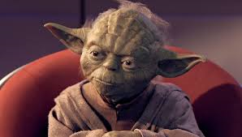
Passing the Torch
Enabling the Next Generation of IT Management Professionals

Slide 3
Who Is This Guy?
Born : London, England (a while ago) – born and bred Cockney
Lived in Canada since 1953
Toronto (29 years)
Edmonton (19 years)
Halifax (17 years)
Married (to a girl from Springhill, N.S.) 47 years (well trained)
4 children, 8 grandchildren
Musician, photographer, renovator
Notes:
Troy, will focus on implementations the last two months.

Slide 4
The Long and Winding Road
Project Director (Emergis) Newfoundland and Labrador Drug Information System
Project Director Nova Scotia Wait Times Project
Project Director : Nova Scotia EMR Adoption Project
9.5 years Government of Ontario (IT & Project Manager)
5 years Government of Alberta (IT Director)
Executive Director, e-Health Nova Scotia Department of Health and Wellness
Director, Atlantic health Practice – Deloitte
Director Consulting Services/Atlantic Health Practice – Sierra Systems
Manager IT Practice: Coopers & Lybrand
1966
?
5.5. years in Canadian motion picture industry
Partner : Sierra Systems
CIO Liberty Health Insurance
Vice President Retail IT Services : Maritime Life Assurance
CIO Alberta Cancer Board
CIO Provincial Mental Health Board
Project Director: Canadian Blood Tracking System
Project Director : Alberta Wellnet

Slide 5
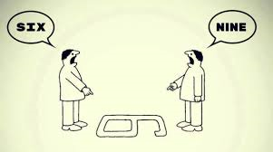
Perspective on Mentoring
Notes:
Troy, will focus on implementations the last two months.

Slide 6
Mentoring
What it Is
Counsel borne of experience
Situation-specific
Demonstrated positive behaviours
Creating a safe environment to fail in
Living what you preach
Accepting accountability for your advice
What It is Not
Arbitrary or textbook answers
Playing the older and wiser card
Be Careful- The Road to Hell……..

Slide 7
Mentoring: Evolution of Maturity
Ready
Aim
Fire
Aim
Fire
Ready
Fire
Aim
Ready

Slide 8
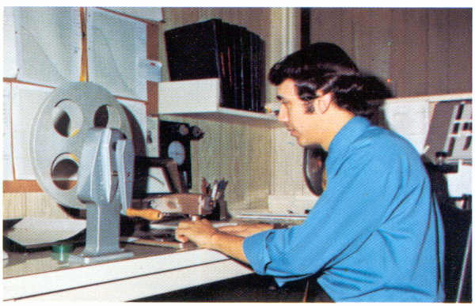
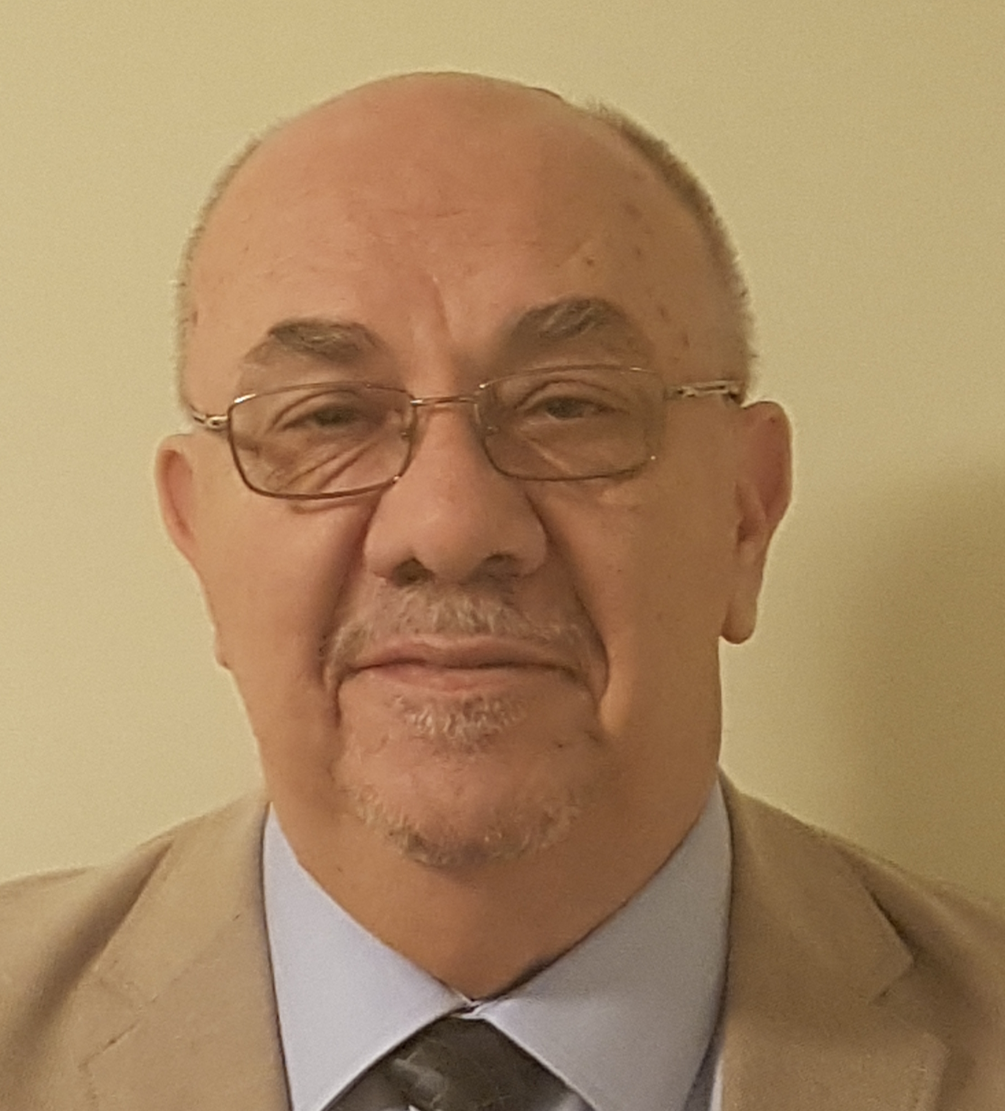
I Was So Much Older Then
I’m Younger Than That Now

Slide 9
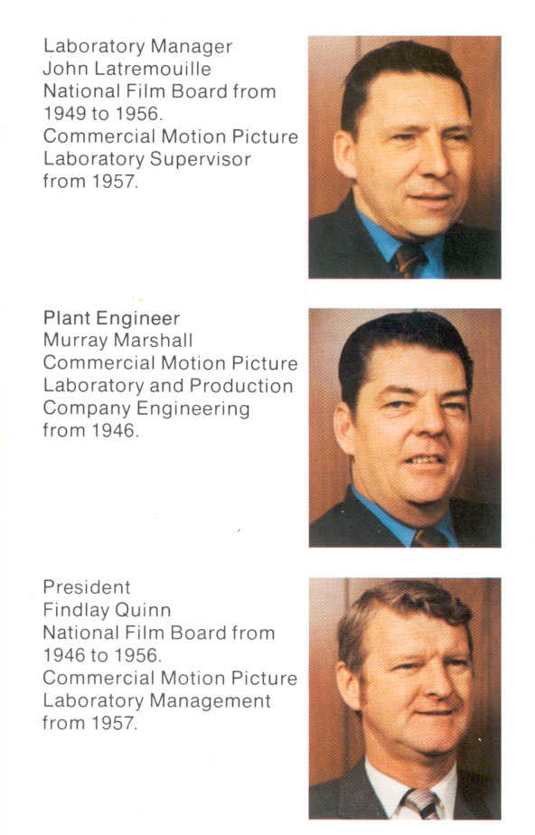
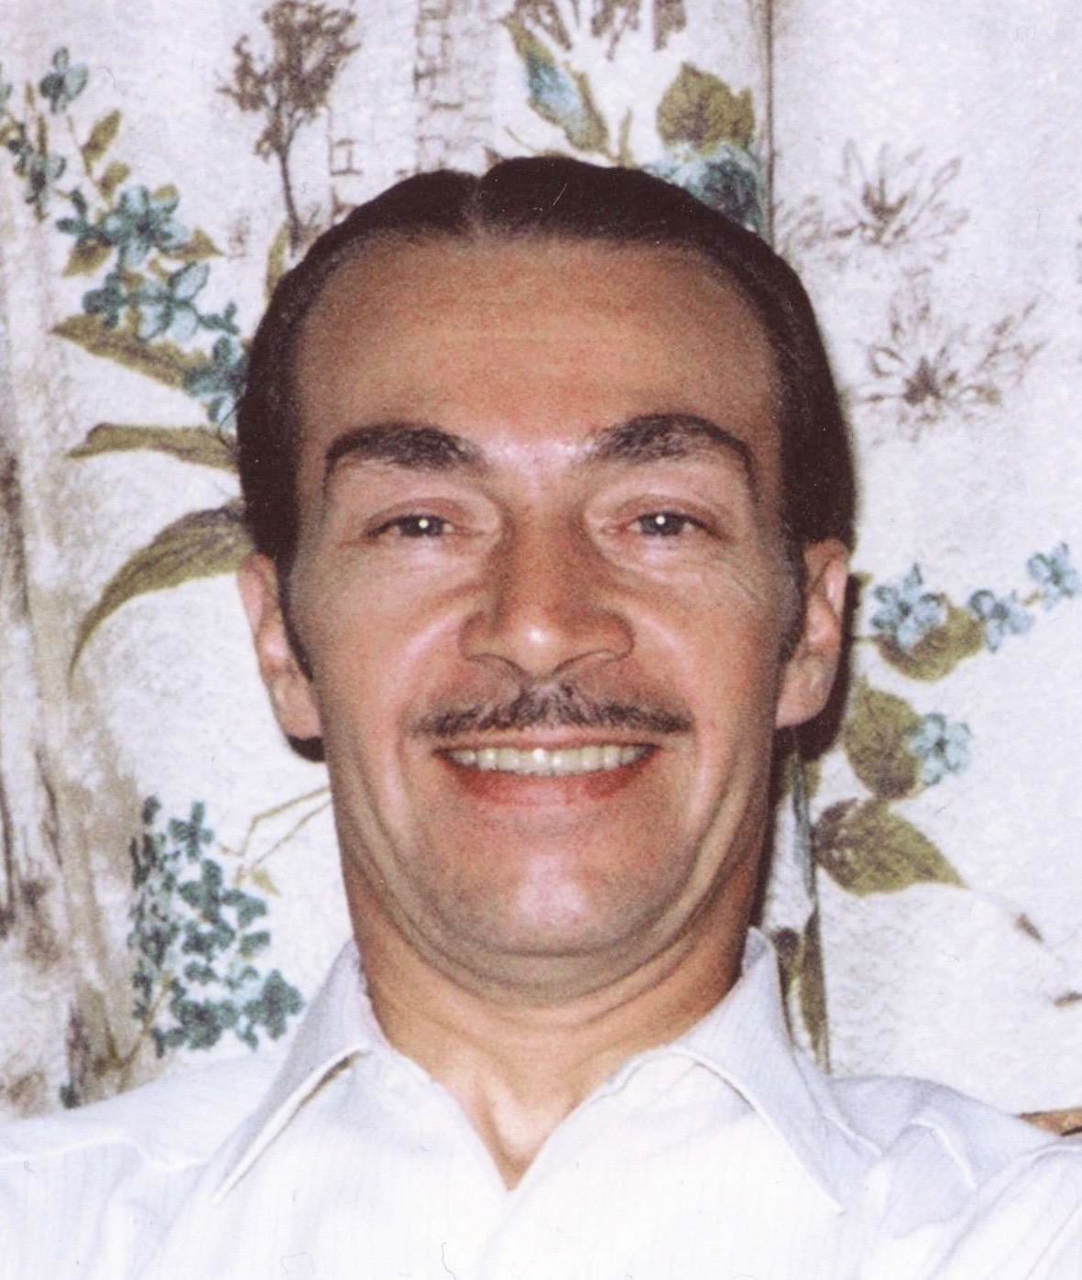
My Mentors

Slide 10
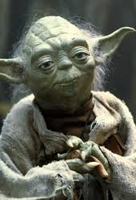
Lessons Learned
Failing is OK
Success is good but fleeting
Enjoy the success of those you mentor
Treat everyone with respect
Communicate effectively
Be willing and capable of changing your mind
Convention was made to be tested, and broken if necessary
Managing relationships is everything, the rest is task work
We are all flawed so become self aware
Seek out your inner Yoda

Slide 11
Riding The Wave of IM/IT Evolution
Life should not be a journey to the grave with the intention of arriving safely in a pretty and well preserved body, but rather to skid in broadside in a cloud of smoke, thoroughly used up, totally worn out and loudly proclaiming “What A Ride!”
- Hunter S. Thompson

Slide 12
Riding The Wave of IM/IT Evolution
Some Misconceptions
History Or Experience Doesn’t Matter Because Everything Is Different Now
Everything Is New
Everything Is The Same Old Thing With A New Set Of Clothes
Some Realities
We Live On The Horns Of Dilemma
We Have To Adapt to Change When We Are The Change Agents

Slide 13
Riding The Wave of IM/IT Evolution Adapting to Change When You are The Change Agent
Impact Of Communications Technology
Changes in Lifestyle
Generational Alignment
Diversity
Pervasive and Evolving Technology
Perceived Erosion of Our Value Systems

Slide 14
Riding The Wave of IM/IT Evolution Adapting to Change When You are The Change Agent
Accept and Manage
A Rapid Rate of Change
Educational and Skill Rebirth and Redundancy
Balancing Fundamentals with New Skill Demands
Not Losing Sight of What Matters
Knowing What to Keep – What to Discard
Stress Created by the Steep Decline in Our Own or Others Value Systems

Slide 15
Thoughts on Experience:
Time Does Not Necessarily Equal Experience
We All Owe Someone
Bad Experience Can Be Good Experience
Not All Experience is Good Experience
Revisit, Re-examine, Seek Out the Gems
Experience That Matters is based on
Wisdom
Honest Retrospective
Evolution of Maturity
Self Awareness Matters!

Slide 17
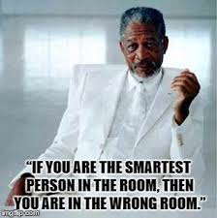
Becoming Self Aware

Slide 18
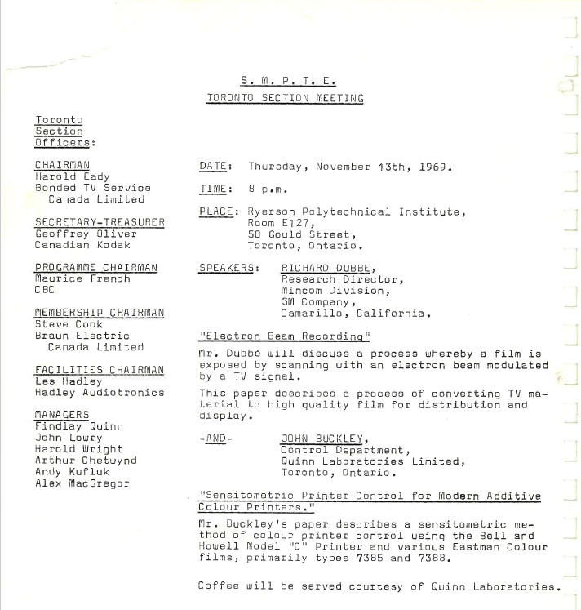
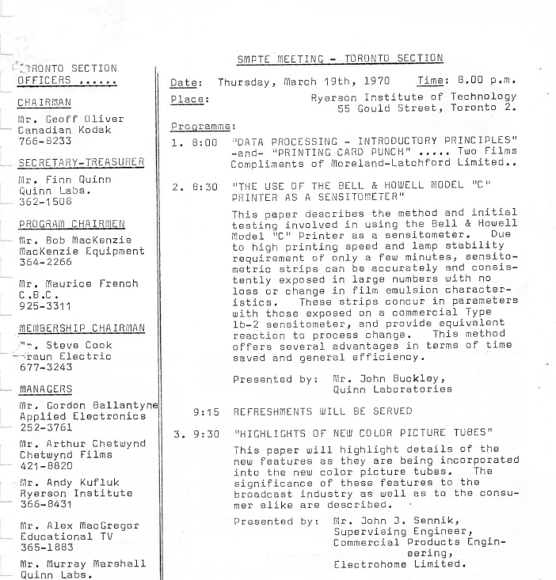
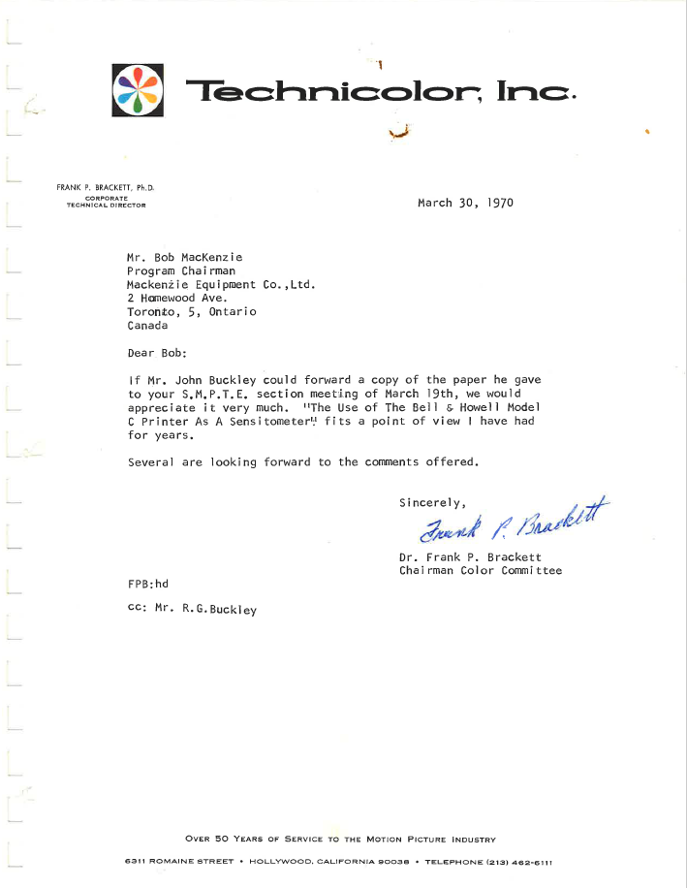
Smartest Guy In The Room Until I Wasn’t!

Slide 19
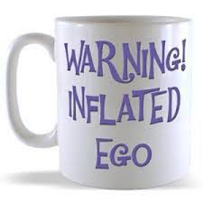
Becoming Self Aware

Slide 20
Becoming Self Aware: Lessons Learned
Being Smart or Right Wasn’t That Important
Understand How You Are Perceived From the Other Side of the Desk
Recognize When Behaviour Is An Impediment
Recognize the Line Between Confidence and Arrogance– its pretty thin!

Slide 21
Becoming Self Aware: It’s A Process!
First: Understand Your Strengths and Accept your Weaknesses
Second: Understand Your Behaviours
Third: Develop The Ability to Change Your Behaviours

Slide 22
What Is Our Professional and Moral Responsibility to Enable the Next Generation?
Give Back

Slide 23
Professional and Moral Responsibility to Enable the Next Generation
Do No Harm
Be Transparent, Objective and Willing to Change Your Mind
Provide Learning Opportunities
Honestly Acknowledge Success and Failure
Pay Attention
Calibrate your Choke Chain
Own The Accountability of Giving Advice

Slide 24
Some Personal Inspirations
Everyday People Who Demonstrate Humility, Reasonableness, Wisdom And Deliberate Thinking
Watching Others – Learn by Example and Observation
Accepting Encouragement
Acknowledging Your Good Fortune
Take Inspiration From The Models Of Your Time

Slide 25
Some Personal Inspirations
“We Choose to Go To The Moon and Do These Other Things, Not Because they are Easy But Because They Are Hard”
John F. Kennedy Jan 1961
“Just Watch Me”
Pierre Trudeau October 1971
“If It Wasn’t For The People, Said Finnerty, If It Wasn’t For The God Damn People, Earth Would Be An Engineers Paradise”
Kurt Vonnegut
“Then there are the jerks”
Unknown

Slide 26
Closing Thoughts
Don’t forget where you started
Learn to be comfortable in your own skin
Write your life story.. It is more interesting than you think

Slide 27
Hope you enjoyed the presentation!
Please take a moment and complete our
Speaker Survey at: www.pdsummit.ca
Feedback is a gift and its the only way we can make PDS 2019 even better!

