Slide 1
Blockchain and the IOT
Including Current Uses
James Slupsky
September 2017

Slide 2
Problem Statement
The Internet of Things, IoT, offers us the opportunity to significantly increase the interconnectedness of devices, offering us new and convenient functionality, but significant security concerns remain. This talk is not concerned with the IoT in general, but with a specific sub-problem within this domain:
Given a collection of sensor devices, each offering a service to provide the information they collect, and given a set of users that wish to make use of this information, how to I ensure the following:
  That the information is secure, in that only those authorized to view the information can do so?
  That the information available hasn’t been tampered with?
In short, how do I create a trust in this system?
Notes:
Let’s start with two examples, and then we’ll dive into the details a bit more

Slide 3
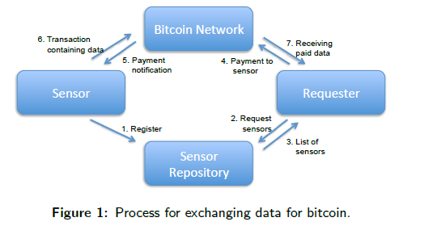
Internet of Things and Blockchain
One Example
When Your Sensor Earns Money:
Exchanging Data for Cash with Bitcoin
Dominic Worner
Thomas von Bomhard
Notes:
In this diagram, a fee is paid for a requester to get data from a sensor. Bitcoin is suggested as the DCL mechanism to use. Sensors would need to encrypt the data using a public key, and as part of the transaction to obtain the data, the requester would receive the private key necessary to decrypt the data. Bitcoin network ensures that the data is transferred to the requester, and that the requester’s money is transferred to the sensor. The ability for sensor providers to earn money from their sensor networks provides an incentive for them to create and maintain a sensor repository, and make those networks widely available.
Such a scheme does have drawbacks:
First, the purchased data is publicly available in the blockchain which would stimulate free riding. This could be addressed by encrypting the data with the requester's public key whereon the requester client decrypts the data using its private key.
Second, in order to provide the measurement data immediately we accept 0-conrmation payments which a requester may be able to exploit by an attempt to double spend.
Third, there are scaling issues. The blockchain would be bloated with transactions and exchanged data would be stored forever on every Bitcoin node and sensor would have a large number of tiny unspent transaction outputs which are expensive to spend.

Slide 4
Internet of Things and Blockchain
Generic Example Example
Data
Storage
Data
Data
Data
Data Hash
DCL
Network
Consumer
Transaction containing hash of data
Sensor
Register
Sensor Info
Sensor
Registry
Notes:
In this diagram, sensors create transactions containing the data. The DCL (or blockchain) network verifies the data is authentic by comparing the hash generated by the sensor against the data stored in the storage area, and creates blockchains containing the hashes of the data. Consumers can then access the data knowing it is the “source of truth”. By comparing the data hash stored in the blockchain against the actual data stored in the storage, consumers can trust that the data has remained unchanged. Since the link to the data and it’s hash are stored in the blockchain, and the DCL network only allows additions to the blockchain for verified data, this trust is maintained.

Slide 5
What Is Blockchain?
Blockchain is a revolutionary cocktail of technology
  distributed systems,
  P2P networks,
  hashing functions
  elliptic cryptography in keys and signatures
The result is a system that builds trust in a basically untrustworthy system.
The sum of these components is a digital, distributed ledger that records semi-public, inalterable and timestamped bundles of transactions known as blocks. Each block has a unique identifier or signature that is used to indicate its location on the blockchain by including the signature of the block that directly precedes it.
It was introduced by an anonymous person or group of people under the name Satoshi Nakamoto in a white paper distributed on a cryptography mailing list in 2008.
Blockchain is the foundation to the most widely-used digital currency, Bitcoin.
Although Bitcoin was the first successful implementation of blockchain, the technology is not limited to digital currencies.
Notes:
To understand how this works, let’s begin with a review of what Blockchain is.

Slide 6
Blockchain ≠ Bitcoin
Notes:
While Bitcoin is arguably the most known implementation of the Blockchain protocol, it is just that, an implementation. There are several other implementations of Blockchain that are perhaps more suited to use in the IoT. Let’s dig a bit deeper into how Blockchain works to understand.

Slide 7
How Does Blockchain Work?
When a block is recorded, it’s run through a cryptographic hash function that takes a message of any size and spits out a fixed-size alphanumeric hash specific to that block.
  It is essentially a digital fingerprint for a block.
  After being assigned a hash, a block must be verified to be added to the blockchain.
The distributed systems on which blockchains run are vital to the success of the technology.
  Nodes on the network must come to a consensus to add a block to the blockchain.
  Each node is equal and owns a full copy of the ledger, meaning that the system is incorruptible and no one truly owns it.

Slide 8
Important to Remember
I need to trust the information gathered from sensors for it to be useful
Distributed legers create that trusted source
Because those legers are widely distributed, I have both easy access and redundancy

Slide 9
How Does Blockchain Work?
Block 1545
Block 1546
Block 1547
Block Hash
Previous Block Hash
Transaction
Transaction
0ef152435c
12ff3b24cd
Block Hash
cd24e1d2c3
Previous Block Hash
0ef152435c
Transaction
Block Hash
34d144231a
Previous Block Hash
cd24e1d2c3
Notes:
Each block contains a hash, timestamped batches of recent valid transactions, and the hash of the previous block. The previous block hash links the blocks together and prevents any block from being altered or a block being inserted between two existing blocks. Subsequent blocks strengthen the verification of the previous block and hence the entire blockchain. The method makes it very easy to detect tampering of the blockchain, lending to the key attribute of immutability.

Slide 10
How Does Blockchain Work?
Initiate Transaction
Post and Record Transaction
Broadcast
Multiple Parties Transact
All transactions are recorded including the date, time, parties, transaction specific, etc
Transaction is added in order into a block
Entries can be added but not deleted
Each node in the network owns a complete copy of the leger
Block is broadcast to every node in the network
Validate via consensus
Network verifies, validates and approves
Consensus is recorded and injects the trust in the system
Immutable and Encrypted Block
Confirmed block is added in chronological order
Transparent record of transactions, audit trail, and digital fingerprints
Data is pervasive and persistent
Transaction Completed
Nodes have access to a single source of truth
Completed block gives way to the next block in the chain
Notes:
Initiate Transaction
Multiple Parties Transact
All transactions are recorded including the date, time, parties, transaction specific, etc
Post and Record Transaction
Transaction is added in order into a block
Entries can be added but not deleted
Each node in the network owns a complete copy of the leger
Broadcast
Block is broadcast to every node in the network
Validate via consensus
Network verifies, validates and approves
Consensus is recorded and injects the trust in the system
Immutable and Encrypted Block
Confirmed block is added in chronological order
Transparent record of transactions, audit trail, and digital fingerprints
Data is pervasive and persistent
Transaction Completed
Nodes have access to a single source of truth
Completed block gives way to the next block in the chain

Slide 11
Blockchain Key Attributes
Shared Leger
An append only system of record shared across the network
Permissions
Ensures only authorized visibility
Consensus
All parties agree to network verified blocks of transactions
Smart Contract
Transactions are secure, authenticated, and verifiable
Business terms embedded in transaction and executed with transaction
Notes:
It is the shared leger and smart contract features in Blockchain that lend themselves well to the IoT.
Shared leger ensures that copies of transactions exist in multiple instances, so from an IoT perspective, I have many sources I can obtain the records from, and I’ve eliminated any single points of failure in providing. I also have a way to detect tempering, both by examining an individual leger, or by comparing two copies of the leger from different nodes in the system (if I’m really paranoid)
Smart contract gives me the flexibility to perform many things with the technology. Not only could I use that feature to store data from sensors, but I can also use it to transact with vending machines, parking meters, toll booths, etc. We’ll get into this aspect in more detail a bit later.

Slide 12
Shared Leger
Permissioned
System of Record
Records all transactions across the business network; the shared ledger is the system of record, the single source of truth.
Shared
Participants see only those transactions they’re authorized to view.
Identification
Participants have identities that link them to transactions, but they can choose the transaction information that other participants are authorized to view.
Through replication, each participant has a duplicate copy of the ledger.
Notes:
The unique feature of Blockchain is a shared, distributed ledger — an immutable record of all transactions on the network, which all network participants can access. With a shared ledger, transactions are recorded once, eliminating any dispute between entities that’s typical of a traditional business network. The leger maintains information about the transaction that was agreed to by both parties at the time the transaction was executed. Because it is immutable, disputes can be resolved easily because the leger contains the source of truth.

Slide 13
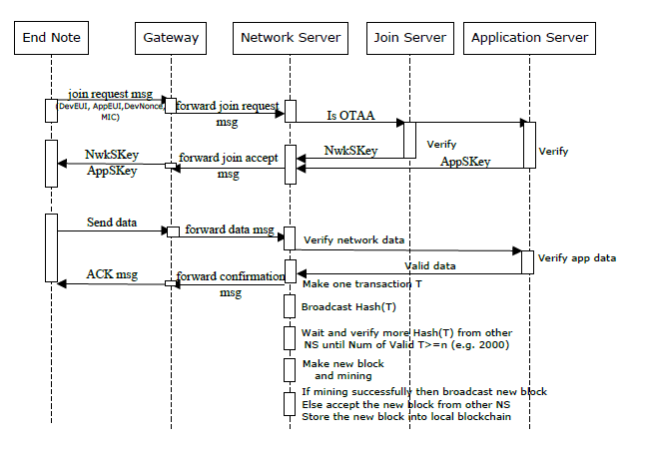
How Data Gets Recorded
Notes:
This diagram shows how data from a sensor network would get recorded into a blockchain network. End nodes, gateways, Join Servers, and Application servers would be outside of the Blockchain network. End node requests to join the network, and the Join server provides a set of crypto keys for use in recording data.
When the sensor has data to record, it forwards it to the blockchain network, which uses the application server to validate the data. Once validated, it is added to the blockchain and acknowledged.

Slide 14
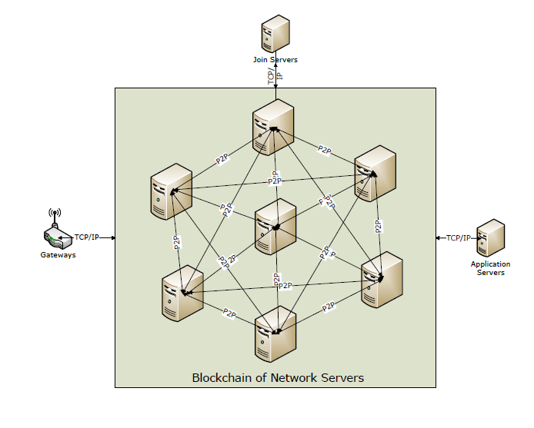
Blockchain Network
Notes:
Since the gateways are generally resource constrained, they may not have the computing power to participate in the blockchain, thus, they are excluded from the network. For redundancy purposes, multiple gateways could be provided, or the gateway function could be implemented within the IoT sensor itself.
The Join Servers are actually servers that provide the certificates or keys used for the encryption. It is possible to provide this using a “digital certificate blockchain”, which we’ll discuss later; however, for the purposes of the sensor network, they are excluded.
The application servers typically provide business functions, and process core data. An entity providing access to IoT sensor data may use these servers to process the data before making it available. Their main function is to validate the data; however, if the sensor data is to be provided raw, these may not be required.
Key here is the network servers. These can be provided by any number of entities, from the actual sensor data providers, to regulators, to various other interested parties. Leveraging a Distributed Leger and Distributed Consensus protocol, the data is maintained by the system in immutable form, on multiple systems.

Slide 15
Preventing the dual payment problem
Bitcoin’s developer Nakamoto has shown that as long as an attacker possesses less than 50% of the computational power in the network, he produces blocks at a lower expected rate than the rest of the nodes,
The probability of a successful attack on a given transaction decreases exponentially as more blocks are added to the chain on top of it.
  Each block added provides “confirmation” to all the transactions in preceding blocks as it supports their inclusion in the ledger.
The network is more secure the more computational power there is in the hands of honest nodes.
The costs of a mining operation capable of mining even 10% of the blocks is extremely high, establishing a barrier against double spending attacks of transactions that are deeply embedded in the chain.
Notes:
Bitcoin’s Proof of work is used to make block creation difficult, helping to prevent the dual payment problem. To ensure blocks are created in expectation once every 10 minutes, the threshold
for successful block creation is adjusted automatically every 2,016 blocks. If, for example, blocks were created too quickly (as is often the case if additional hashing
power was added to the network since the previous adjustment) the difficulty is raised by lowering the target threshold.
Because blocks are only created every 10 min in Bitcoin, it is not necessarily a suitable protocol for use in an IoT blockchain. Indeed, the environmental cost of the power needed to perform the proof of work calculations in Bitcoin is enormous, and will only increase. This adds a very real cost to the generating blocks.

Slide 16
Incentives in Bitcoin
Bitcoin encourages mining activity and thus indirectly increases the system’s resilience.
Miners are awarded with bitcoins in return for their effort:
  Each transaction offers a small fee claimed by the node that includes it in a block.
  This encourages nodes to join the network, to collect transactions, and include as many of them as possible in blocks.
  As a side effect, they contribute their computational power toward improving the network’s resilience to double spending.
In addition to fees, creators of blocks are awarded newly created bitcoins. These are issued to the block’s creator in a special transaction included in each block called the coinbase transaction.
Bitcoin’s money creation is gradual, and occurs according to a fixed schedule. Instead of launching the system with all coins in the hands of a single individual, their distribution is spread over time.
Starting with the Genesis Block, each new block issued 50 bitcoins. The number of bitcoins generated in this manner is halved every 210,000 blocks (approximately every four years), and so the total sum of bitcoins that will ever exist is nearly 21 million.

Slide 17
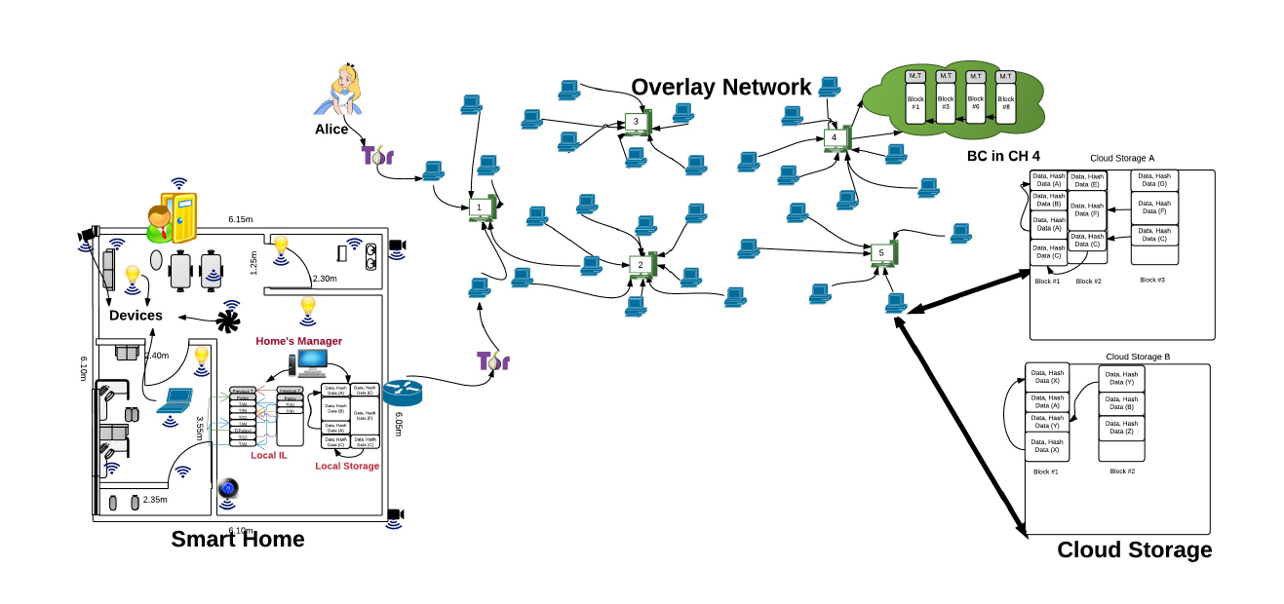
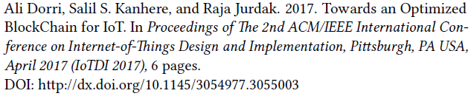
Another example to show Cloud Storage
Notes:
Let’s look at a proposed architecture that addresses some performance concerns, while maintaining security..
This one is built to store Smart Home data. Here, rather than storing the data in the blockchain, the hash of the data is stored in the blockchain network and distributed. That way, the fact that the data changes is visible to everyone in with access to the blockchain network. In this example, nodes in the blockchain network are clustered and connected to cluster heads. Cluster heads are responsible for generating the new blocks, and nodes can join other clusters if they experience excessive delays. Also, nodes in the cluster can elect a new cluster head at any time.

Slide 18
Addressing Performance and Security
Users that have no history must have all transactions verified
Transactions are verified by
  Comparing the hash of the current transaction Public Key with the output Public Key of the previous transaction.
  Verifying the requester signature using the Public Key in the transaction
  Ensure only one of the outputs of the current transaction is increased by one (such as # of successful transactions or number of rejected transactions)
In the overlay network each cluster head maintains a trust rating for the others based on direct and indirect evidence.
  A has direct evidence about CH B if it verified a block generated by B.
  If A receives a block generated by B and A has no trust in B, but one or more cluster heads signed the block as a valid block, then A has indirect evidence about B.
Notes:
A deeper dive into the architecture shows us how the authors of this architecture propose to eliminate Proof of Work overhead while distributing trust.

Slide 19
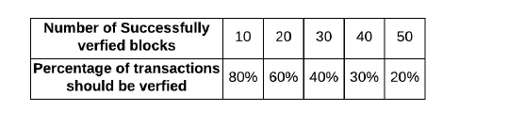
Addressing Performance and Security
When a cluster head generates a new block it has to create a multi-signature transaction which is used for evaluating trust.
  The Cluster Head then sends both the block and multi-signature transaction to its neighbors.
  Neighbors check the multi-signature transaction for direct or indirect evidence.
  If the neighbor has direct evidence with the block generator or other cluster heads who signed the multi-signature transaction, then it randomly verifies a portion of the transactions in the block by checking their signatures.
  The portion of transactions that need to be verified change as a function of the number of successfully verified blocks for the corresponding cluster head.
Notes:
Note that, a certain portion of transactions must be verified even when a CH is deemed to be trustworthy to protect the network against CHs which may have been recently compromised.
If a CH has no direct evidence with the block generator or those who signed it, then it checks all transactions in the received block. If a single block is generated by more than one CH, then other
CHs would accept the one that is appended by the CH which has the highest trust to decrease the validation processing overhead due to the act of distributed trust. This may result in a forked BC.
However, all forked blocks are assumed to be valid. The CHs append newly received blocks to the longest chain of blocks which ensures BC consistency.
This framework exhibits graceful degradation in that the resilience degrades as the number of compromised nodes increases. The probability of detecting the fake block is a function of the number of total CHs, which presents an interesting trade-off for the system designer.

Slide 20
Sequence Diagram below of storing/accessing
Sensor
SHM
Storage
Cluster Head
Service Provider
Data
Data + ID
Data Hash
Data Hash
Request
Transaction
Data Request
Data
Encrypted Data
Transaction Copy
Notes:
Let’s assume that Alice has created an account in a cloud storage facility and set up permissions for her thermostat to upload data to this facility. During the bootstrapping process, the cloud storage returns a pointer to the first block of data. When the smart thermostat needs to store data in the cloud storage, it sends its data to the Smart Home Manager. After checking permissions and extracting the previous block-number and hash from the local Immutable Leger, the SHM creates a random ID and sends data to the storage with this ID. It is assumed that at any given time, two nodes cannot have the same ID. The storage checks the validity of the transaction by locating data using given parameters and also confirms that there is space available in the cloud storage. If so, it calculates a hash of received data packets and compares it with the received hash in the transaction. If the two hashes match, then data packets are stored in the storage and the new block-number is encrypted with the SHM PK, to make sure that only the true SHM can read the new block-number, and sent to the SHM. Next, the signed hash of data is signed by the storage and sent to the overlay network to be stored in the overlay BC. This ensures that any further changes in the user’s data are visible to all. In each smart home there is a private secure storage managed by the SHM. The SHM distributes a shared key between authorized IoT devices and the local storage. IoT devices use this key for generating store transaction. Local storage is managed by the owner of the home and is trusted. Therefore, there is no additional overhead for accounting. To access stored data of a device, the SP creates and signs the requester part of a multisig transaction. The SP then sends this to its own CH. The CH checks both lists of PKs. If either the multisig transaction’s requester is in the CH requester’s key list, or the transaction’s requestee is in its requestee’s key list, then it broadcasts the transaction to its own cluster. Otherwise, the transaction is broadcast to other CHs. When the requestee (SHM) receives the multisig transaction, it authorizes the SP by checking the local policy in the local IL. If so, the SHM requests data from the storage, encrypts them with requester’s PK, and sends them to the requester (the SP). After sending data for the requester, the SHM should store the multisig transaction in the local IL to keep the history of transactions. In addition, the SHM sends the multisig transaction to its CH to be stored in the overlay BC as a history of requester transactions.

Slide 21
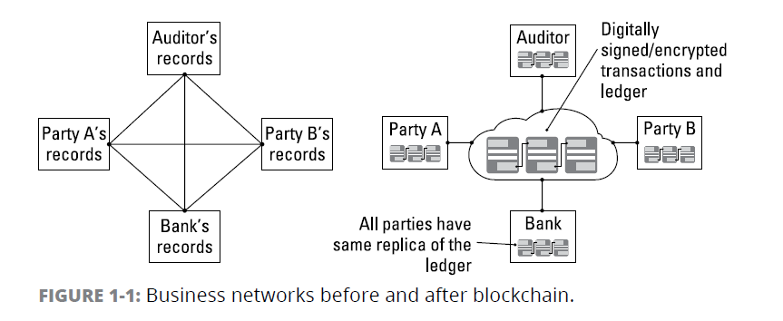
Permissions
From “Blockchain for Dummies, IBM Limited Edition” by Manav Gupta
Notes:
Blockchain protocols can be implemented with the ability to restrict access to transaction details. In doing so, more transaction detail can be stored in the blockchain (such as sensor data) by encrypting that information using a public key, and providing participants with a private key allowing them to view transaction information they’re authorized for (or have an agreement to view). In addition, some participants may be authorized to view only certain transactions, while others, such as auditors, may be given access to a broader range of transactions.
For example, if Party A transfers an asset to Party B, both Party A and Party B can see the details of the transaction. Party C can see that A and B have transacted but can’t see the details of the asset transfer. If an auditor or regulator joins the network, privacy services can ensure that they see full details of all transactions on the network. Digital certificates could be used to enable this.
Just like a passport, a digital certificate provides identifying information, is forgery resistant, and can be verified because it was issued by a trusted agency. The blockchain network will include a
certification authority who issues the digital certificate.

Slide 22
Consensus
Proof of stake:
Proof-of-stake might provide increased protection from a malicious attack on the network by reducing incentives for attack and making it very expensive to execute attacks.
Multi-signature:
Practical Byzantine Fault Tolerance (PBFT):
To validate transactions, validators must hold a certain percentage of the network’s total value.
A majority of validators (for example, three out of five) must agree that a transaction is valid.
An algorithm designed to settle disputes among computing nodes (network participants) when one node in a set of nodes generates different output from the others in the set.
Notes:
In a business network where participants are known and trusted,
transactions can be verified and committed to the ledger through
various means of consensus (agreement), some of which are shown here
Blockchain for business features pluggable consensus — a way to
implement whichever consensus mechanism is deemed best for
any given industry segment.
The fact that a set of nodes in the system must reach a consensus before a block is added to the chain provides additional resistance to tampering.

Slide 23
Ethereum and Proof of Stake Consensus
The blockchain keeps track of a set of validators
  Anyone holding cryptocurrency can become a validator by locking up their cryptocurrency holdings into a deposit
  The deposit is forfeit if it is determined the validator acts against the rules
The process of creating and agreeing to new blocks is then done through a consensus algorithm that all current validators can participate in
  In chain-based proof of stake, the algorithm pseudo-randomly selects a validator during each time slot (eg. every period of 10 seconds might be a time slot), and assigns that validator the right to create a single block, and this block must point to some previous block (normally the block at the end of the previously longest chain), and so over time most blocks converge into a single constantly growing chain.
  In BFT-style proof of stake, validators are randomly assigned the right to propose blocks, but agreeing on which block is canonical is done through a multi-round process where every validator sends a "vote" for some specific block during each round, and at the end of the process all (honest and online) validators permanently agree on whether or not any given block is part of the chain. Note that blocks may still be chained together; the key difference is that consensus on a block can come within one block, and does not depend on the length or size of the chain after it

Slide 24
Ripple and Federated Consensus
Under the federated consensus protocol, blocks are considered accepted once they have been signed by a specified quorum of block signers. This is implemented using a consensus program that checks an “M-of-N multisignature” rule, where N is the number of block signers, and M is the number of signatures required for a block to be accepted.
The program specifies the public keys of each of the N block signers. The signatures are passed in the arguments. The program checks the signatures against the pre-specified public keys to confirm that they are valid signatures of the hash of the new block.
New blocks may reuse the same consensus program or change it to a new one (as when members join and leave the federation) as long as a quorum of block signers approves the change.
The values of these parameters, M and N, can be tweaked according to business requirements or the security parameters of the network.
There is a single block generator in the network
Notes:
To efficiently do so, block signers agree on a single block generator. The generator’s signature is only used to coordinate the block signers; it is not seen or validated by the network. This allows block signers to evolve the consensus mechanism without any additional support from the rest of the network.
The block generator:
receives transactions from the network,
filters out transactions that are invalid,
filters out transactions that do not pass local policy checks,
periodically aggregates transactions into blocks,
sends each proposed block to the block signers for approval.
Each block signer:
verifies that the proposed block is signed by the generator,
verifies that the block is valid under its (the signer’s) current state without checking that the previous consensus program is satisfied (which requires the block signers’ signatures),
verifies that it has not signed a different block at the same or greater height,
verifies that the block timestamp is no more than 2 minutes ahead of the current system time,
verifies that the block contains an acceptable consensus program (for authenticating the next block),
if all checks passed, signs the block.
Once the block generator receives signatures from enough block signers (as defined by the previous block’s consensus program), it publishes the block to the network. All network participants, including the block signers, validate that block (including checking the previous consensus program is satisfied) and update their state.
Safety — specifically, the assurance that a valid block is the only valid block at that height — is guaranteed as long as no more than 2M - N - 1 block signers violate the protocol. For example, if the consensus program requires signatures by 3 of 4 block signers, the blockchain could only be forked if 2 block signers misbehave by signing two blocks at the same height.
An attempt to fork the blockchain by signing multiple blocks can be detected and proven by anyone with access to both block headers. Network participants could implement a gossip protocol to share block headers and detect an attempted fork immediately, as long as the network is not partitioned. Double-signing can be proven after the fact, and dealt with out-of-band.
Another potentially desirable safety guarantee is the assurance that, if a block header’s consensus program is satisfied, there is a corresponding valid blockchain history — i.e., no transaction is unbalanced and all programmed conditions are satisfied. This guarantee is assured as long as no more than N - M block signers are faulty.
This latter guarantee is useful for clients that do not have full visibility into the blockchain, instead using compact proofs to check some transaction or piece of state against the block headers. Network participants that have visibility into entire blocks and has seen the entire history of the blockchain — or which trust some other party which does have such visibility — have no need to trust block signers for this particular guarantee.

Slide 25
Smart Contract
A smart contract is an agreement or set of rules that govern a business transaction; it’s stored on the blockchain and is executed automatically as part of a transaction.
Eliminates the need for intermediaries in typical transactions.
Users can trigger a contract by sending a transaction to its address.
Once a smart contract transaction gets included in the blockchain, everyone in the network is expected to execute the contract script to verify its validity
Notes:
In a distributed marketplace, the intermediaries normally necessary to facilitate payments are eliminated. Buyers and Sellers transact using smart contracts that can be verified by the nodes within the marketplace. Each node has the ability to verify the contract, acting to provide trust in the overall marketplace.

Slide 26
Benefits of Blockchain
Shared Leger
Transactions are recorded and cannot be repudiated
State based Communication
Messages can be sent that include the state of a task in a transaction
Participants can update the state of the task and share the results with everyone
Peer 2 Peer
Transaction and transaction histories are available to all participants in the network
Intermediaries are avoided, reducing cost
Consensus
Intermediaries are replaced by consensus of the network, which is used to validate and authenticate transactions
Smart Contracts
Smart contracts build the contract into the transaction, establishing the conditions under which a transaction or asset exchange can occur.

Slide 27
Questions?

Slide 28
Hope you enjoyed the presentation!
Please take a moment and complete our
Speaker Survey at: www.pdsummit.ca
Feedback is a gift and its the only way we can make PDS 2019 even better!

