Slide 1
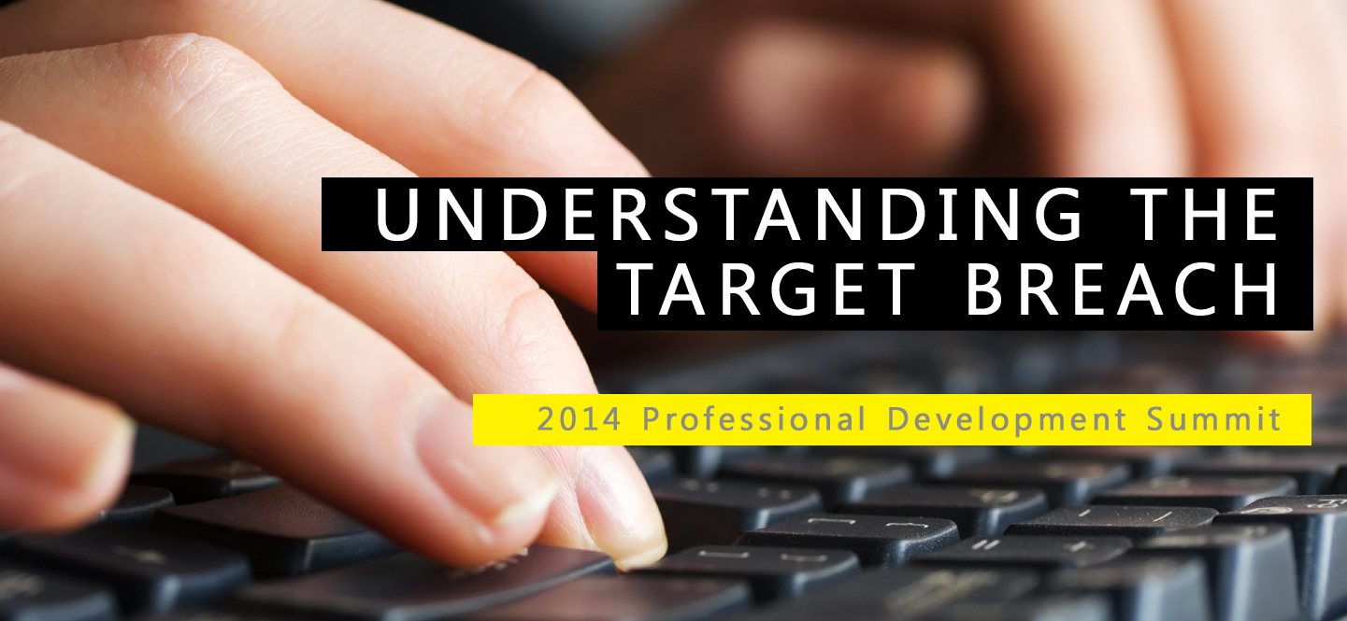


Slide 2
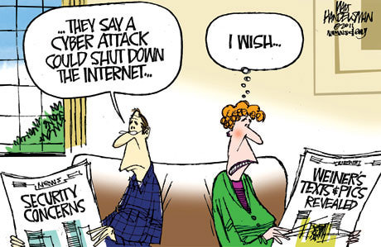
Welcome & Thanks for Having Me!!

Slide 3

Introduction – Peter Morin
Who Am I?
  20+ years experience in Information technology – 12 of those in InfoSec.
  Senior information security consultant for Bell Aliant
  Been teaching for about 8 years (i.e. SANS, US Federal Government, US Army, etc.)
  Worked for KPMG and Ernst & Young
  International Executive board for the High Technology Crime Investigation Association
  CISSP, CISA, CGEIT, CRISC, GCFA, GCIH

Slide 4
Agenda
I want you to take home four important points:
    Understand
    Educate
    Collaborate
    Prepare
Look at the Telus / Rotman Survey
Profile some of the threat actors
Look at the impact of four of the most common types of attacks today.
Look at a quick case study – Target breach

Slide 5
Blurring of Activities
The traditional corporate perimeter, with clearly identifiable boundaries, has diminished.
Firewalls become useless – Data is being shared in ways that current security models may not have considered = Data leakage
Focus is on keeping bad guys out, not data in!
It is the norm for workers to blend business and personal use (i.e. social networks) - further blurring the network perimeter

Slide 6
Blurring of Activities
Traditional in-sourcing has taken a back seat
We are outsourcing more and more to organizations that specialize in the services we are looking for
  IT service management
  Website hosting
  Application hosting
  Offsite backups
  Management of critical systems
  Etc…

Slide 7

Who Gets Attacked?
Nobody is immune
  Multinationals to small business to governments
  Across all industries
  Attacker tactics are numerous and non-stop

Slide 8
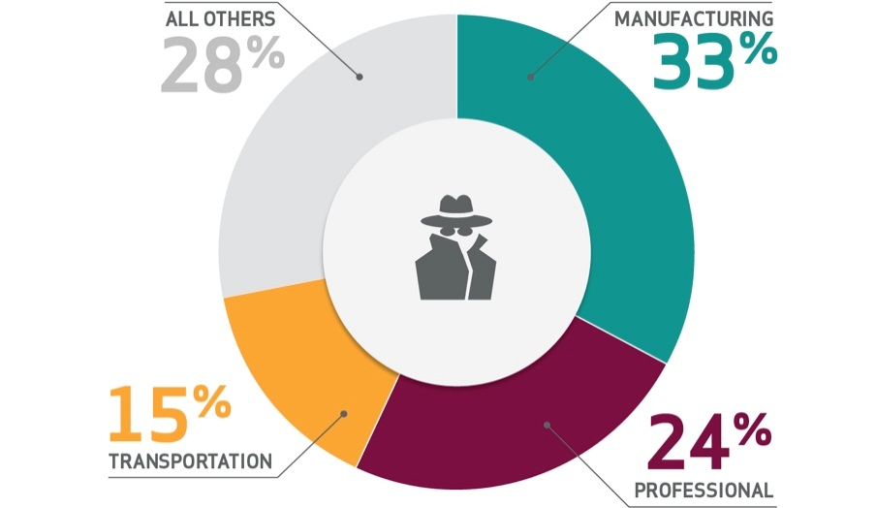
Who Gets Attacked?
Nobody is immune – even from state-affiliated espionage
  State-affiliated actors perpetrated 19% of attacks last year
  Targets are not government agencies, and not just military contractors
  Be aware of the “knock-on effect” in your supply chain
2013 Verizon DBIR

Slide 9
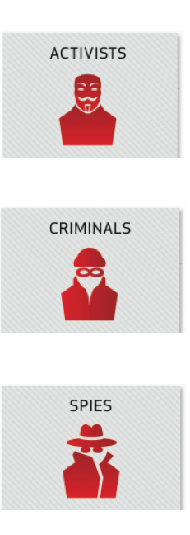
Who Are the Attackers?
Varied Motivations
AIM IS TO MAXIMIZE DISRUPTION
EMBARRASS VICTIMS FROM BOTH PUBLIC AND PRIVATE SECTOR.
MOTIVATED BY FINANCIAL GAIN
WILL TAKE ANY DATA THAT MIGHT HAVE FINANCIAL VALUE.
OFTEN STATE-SPONSORED
DRIVEN TO GET EXACTLY WHAT THEY WANT - FROM INTELLECTUAL PROPERTY TO INSIDER INFORMATION.

Slide 10
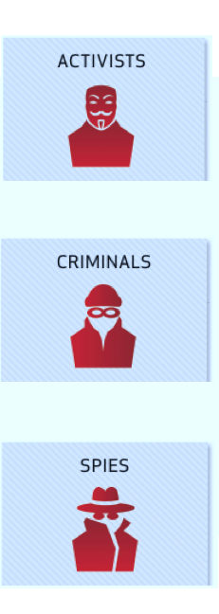
Who Are the Attackers?
Varied Tactics
USE VERY BASIC METHODS AND ARE OPPORTUNISTIC.
RELY ON SHEER NUMBERS.
MORE CALCULATED AND COMPLEX THAN ACTIVISTS IN HOW THEY CHOSE THEIR TARGETS.
CRIMINALS ARE NOW TRADING INFORMATION FOR CASH.
• OFTEN STATE-SPONSORED, USE MOST SOPHISTICATED
TOOLS TO COMMIT MOST TARGETED ATTACKS.
• TEND TO BE RELENTLESS.

Slide 11
What to Worry About?
This year’s biggest threats? Same as last year’s.
  Very few surprises – mostly variations on theme
  75% of breaches were driven by financial motives
  95% of espionage relied on plain-old phishing
Well established threats shouldn’t be ignored

Slide 12
What to Worry About?
What do attackers target? Still the traditional assets.
  It’s still traditional assets (laptops, desktops and servers) that are most at risk — not just web applications.
  Unapproved hardware (such as personal storage devices) accounts for 41% of the cases of misuse

Slide 13
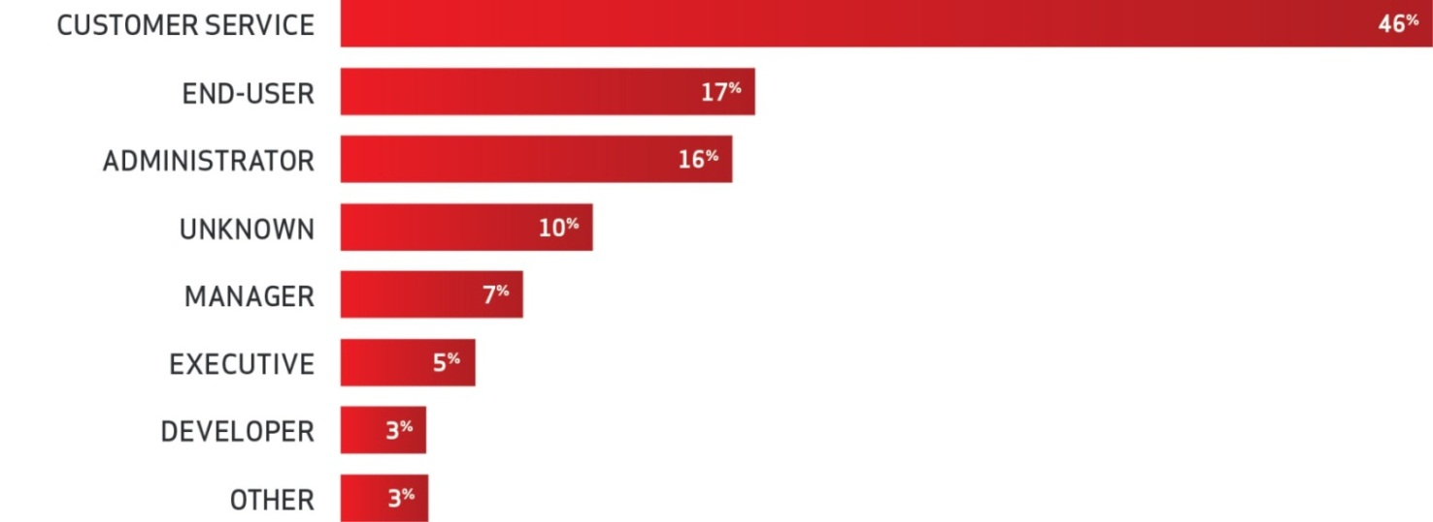
What to Worry About?
Many data breaches have an unintentional element. People across the company.
Taking information home, copying data onto a USB drive, attaching the wrong file to an email or sending it to the wrong person, or leaving a laptop in a cab can all lead to a data breach.
2013 Verizon DBIR

Slide 14
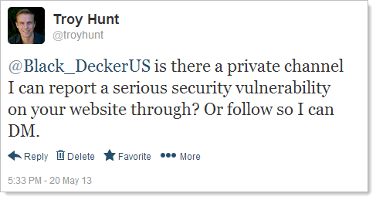
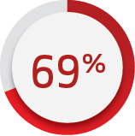
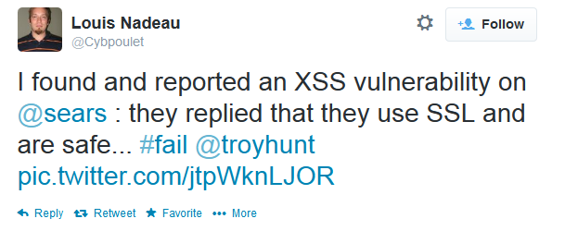
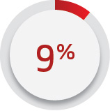
What to Worry About?
Who discovered them? Outsiders such as customers – Can be a scary moment!
OF BREACHES WERE SPOTTED
BY AN EXTERNAL PARTY.
OF BREACHES WERE DISCOVERED
BY CUSTOMERS.
2013 Verizon DBIR

Slide 15
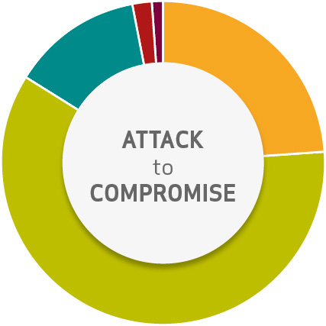
What to Worry About?
Minimal time to compromise
• IN 84% OF CASES, INITIAL COMPROMISE TOOK HOURS OR LESS.
2013 Verizon DBIR

Slide 16
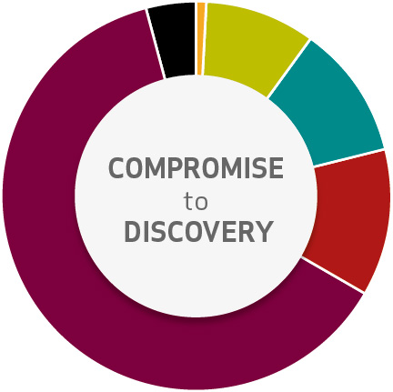
What to Worry About?
Minimal time to compromise. But a long time to discovery.
• IN 66% OF CASES, THE BREACH WASN’T DISCOVERED FOR MONTHS OR EVEN YEARS.
2013 Verizon DBIR

Slide 17


2013/2014 Notable Breaches
The retail store chain acknowledged that up to 110 million customer records (i.e. payment cards) were compromised in a data breach that occurred in the busy Thanksgiving shopping period.
1.1M credit cards were stolen in this breach. The hackers moved unnoticed in the company’s computers for more than eight months, setting off 60,000 unnoticed alerts as they moved around the victim’s network.

Slide 18


2013/2014 Notable Breaches
In June, Facebook disclosed an estimated 6 million Facebook users had e-mail addresses or telephone numbers shared with others due to a software bug in the “Download Your Information” found by a security researcher and reported to Facebook, which fixed it.
Adobe said attacks dating to at least August had exposed user IDs, passwords and credit-card information (stored in encrypted form) on about 2.9 million customers.

Slide 19


2013/2014 Notable Breaches
The financial services firm said a cyber-attack resulted in the compromise of personal information about almost half a million corporate and government clients who held prepaid cash cards issued by JP Morgan Chase.
The cord-blood bank agreed to settle Federal Trade Commission charges it failed to protect customer data due to inadequate security that exposed Social Security and credit-card information on 300,000 people.

Slide 20

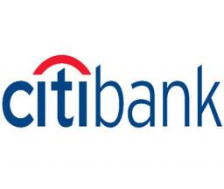
2013/2014 Notable Breaches
Travel health and security services company International SOS in November said information on 164,000 people, including their e-mail, passport numbers and travel information, was accessed by an “unauthorized third party.”
The bank acknowledged 150,000 records related to bankruptcies and other legal proceedings was inadvertently exposed.

Slide 21


2013/2014 Notable Breaches
The federal agency disclosed that data on 104,179 employees was compromised in a cyber-security incident in July.
The U.S. Internal Revenue Service mistakenly posted tens of thousands of names, addresses and Social Security numbers — perhaps as many as 100,000 - - on a government website, a discovery made in July by a group called Public.Resource.org.

Slide 22


2013/2014 Notable Breaches
The university, known as Virginia Tech, disclosed a breach that exposed about 145,000 records of people who had applied for jobs over the past decade.
Heartbleed - breach on the CRA’s website, which resulted in roughly 900 social insurance numbers being stolen.
RCMP arrested Stephen Arthuro Solis-Reyes, of London, Ont., at his home on April 15.

Slide 23


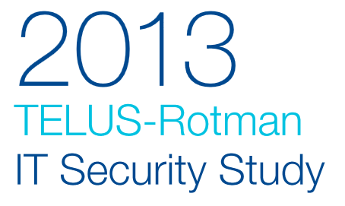

Slide 24

Asked CIOs/CISOs…
“What keeps you up at night?”

Slide 25

2013 Telus/Rotman Study
The biggest challenge is people.
Security is only as good as the people who adhere to your policies and security measures.
Organizations are always at risk if employees aren’t aware of security.

Slide 26
2013 Telus/Rotman Study
We have all been breached, whether we know it or not.
The presence of data, in even what appears to be well-protected environments, very often means a user is one click away from doing something very dangerous accidentally, and we don’t always know how to manage that.

Slide 27
2013 Telus/Rotman Study
Other organizations having experienced very public breaches allows us to have a very different kind of conversation with the board and with the executive team.
Off-shoring and outsourcing poke more and more holes in my perimeter - the erosion of traditional perimeters is a big concern to me

Slide 28
2013 Telus/Rotman Study
Our number one threat concern - loss of trust in our ability to protect customer data.
Being a custodian of customer data is a driver for security.
Employees are our single greatest threat – it’s not malicious, it’s just not knowing.
We can influence our employees and make them aware, but we can’t control their actions.

Slide 29
2013 Telus/Rotman Study
We need to have the controls and tools in place to protect [corporate data on mobile devices].
Conversely, if we weren’t set up with the right foundational tools like mobile device management then it would be a red herring for us.

Slide 30
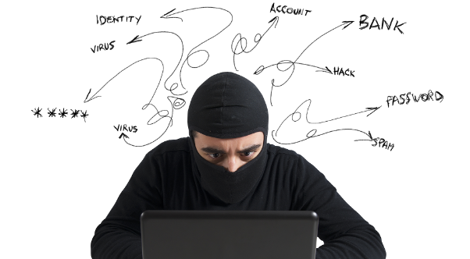
Understanding the
Attacker:
Common Attack Profile

Slide 31
Common Attack Profile
If your organization understands that there is no such thing as perfect security = You’re halfway there!
Advances in technology will always outpace our ability to effectively secure our networks from attackers
This is what is referred to as the “Security Gap” = nothing we can do about it!

Slide 32
Common Attack Profile
Look at the tactics that the adversary is using to compromise organizations
  The subversion of IT contractors
  The extensive reconnaissance used by attacker
  The persistent re-compromise of valuable targets
  Strategic web compromises
These four trends are about the business side of exploitation.

Slide 33
Subversion of IT Contractors
Lots of outsourcing in 2013!
  $134B on finance, accounting, HR, and procurement
  $252B spent on IT outsourcing
Organizations allowing vendors unfettered access to large portions of their networks.
2003 also saw an increase in the number of outsourced providers who were compromised

Slide 34
Subversion of IT Contractors
Attackers compromise the first victim, the outsourcer
Gather the intelligence they need to facilitate their compromise of the second victim
Lay dormant at the first victim for months (or even years)
Only accessing backdoors at those companies if they need to regain access to the second victim.

Slide 35
Extensive Recon Used by Attackers
Comprehensive network reconnaissance allows attackers to navigate victims’ networks faster and more effectively.
Attackers can steal the data they want faster when they know where to look for it.
Basic reconnaissance of victim networks is nothing new
In 2013 we noted evidence of attackers expanding the type of reconnaissance they perform and utilizing more sophisticated tools and to map victims’ networks.

Slide 36
Extensive Recon Used by Attackers
The first documents the attackers frequently stole were related to network infrastructure, processing methodologies and payment card industry (PCI) audit data.
The attackers also took various system administration guides to identify human targets and to further scope the victim networks.

Slide 37
Extensive Recon Used by Attackers
Using this info, attackers identified network and system mis-configurations which they exploited to gain greater access within the network.
This is what we call “pivoting”
Increased intel = faster and more direct access to the areas of their victims’ networks that they were trying to compromise.

Slide 38
Extensive Recon Used by Attackers
In some instances, attackers sought entry to production environments where they stole intellectual property.
In other cases, they were looking to identify network resources the victim shared with other organizations that were also on the attacker’s target list.

Slide 39
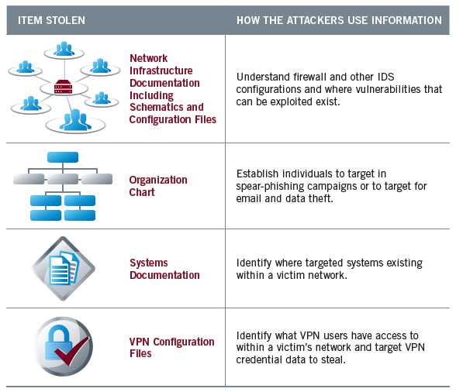
Extensive Recon Used by Attackers

Slide 40
Re-Compromise of Valuable Targets
Attackers continue to target industries that are strategic to their growth
  telecom, aerospace, software, high-tech services, and energy, etc.
Attackers choose their targets for different reasons
  financially motivated attackers seek victims who they can easily can gain access to in order to steal money or credit/debit card numbers

Slide 41
Re-Compromise of Valuable Targets
Attackers conducting economic espionage are motivated by economic gain and their victims are often directly correlated with their national interest.
Larger number of situations where organizations that were initially compromised were repeatedly attacked once those organizations had cleaned up from the breach.

Slide 42
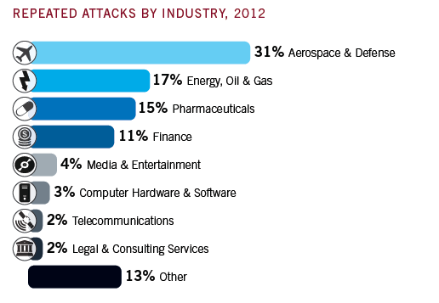
Re-Compromise of Valuable Targets

Slide 43
Strategic Web Compromises
We know…
  Attackers have long used spear phishing and other social engineering tactics to entice users to click on malicious files they receive via email.
  They send the target a well-crafted email with an attachment, the target clicks on the attachment, their machine becomes compromised, and the attacker gains access to the victim’s network.

Slide 44
Strategic Web Compromises
So attackers have…
  As the use of this well-known technique has become more prevalent, technologies have been developed to combat these attacks — and they continue to improve.
  Attackers shift tactics by placing exploits on websites they know are frequently browsed by users in targeted organizations

Slide 45
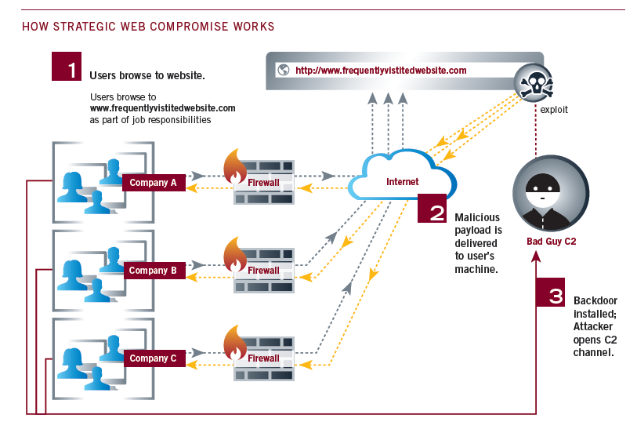
Strategic Web Compromises
Targeted users travel to the compromised website as part of their daily operations
Click on the compromised website, malware is installed on their machines
Malware collects usernames, passwords, browser cookies and the computer name

Slide 46
Strategic Web Compromises
By using these strategic web compromise attacks, the attacker…
  Able to secure access to multiple individuals’ systems within several targeted companies without having to send a single email
  Attacker can defeat anti-phishing technology
Exploiting web servers used to be a crime of opportunity not a targeted, pre-meditated attack

Slide 47
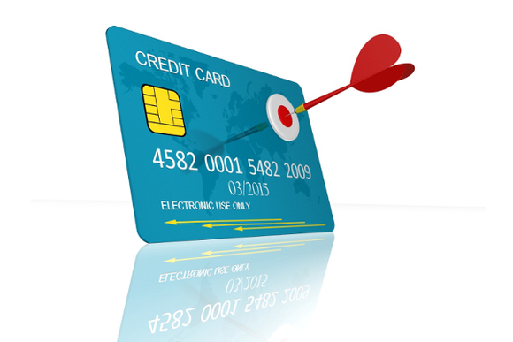
Case Study:
Breach at Target

Slide 48
Target Breach
PCI-DSS compliant
Re-certified in September 2013
Used advanced systems from vendors such as FireEye and Symantec
Large dedicated security team
Maintain a 24/7 security operations center
Target security staff raised concerns about vulnerabilities in the retailer’s payment card system at least two months before the attack
40M CC/debit numbers stolen
Additionally, 70M accounts were compromised that included addresses and mobile numbers.

Slide 49
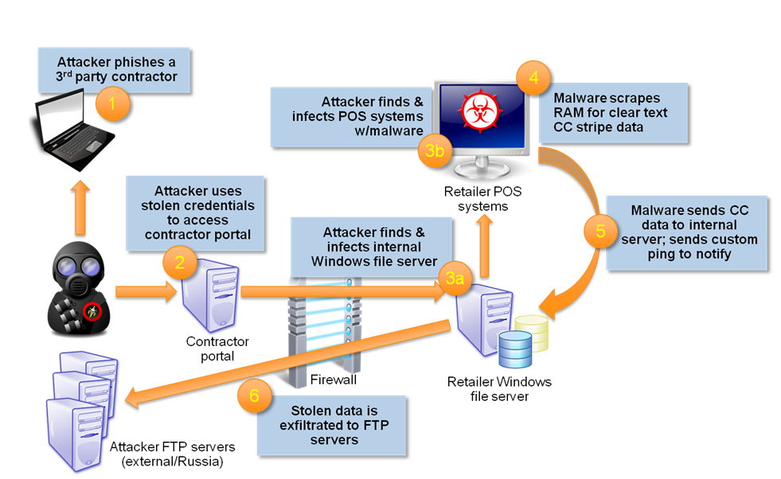
Target Breach

Slide 50
Target Breach
Network access to an third-party vendor, who did not appear to follow broadly accepted information security practices (Phishing!)
The vendor’s weak security allowed the attackers to gain a foothold in Target’s network
Target failed to respond to multiple automated warnings from their anti-intrusion software after the attackers were installing malware on Target’s systems

Slide 51
Target Breach
Initial intrusion into its systems was traced back to network credentials that were stolen from a third party vendor
Fazio Mechanical Services, a Sharpsburg, Penn.-based provider of refrigeration and HVAC systems
Vendor in question was a refrigeration, heating and air conditioning subcontractor that has worked at a number of locations at Target and other top retailers.

Slide 52
Target Breach
Fazio’s data connection with Target was for electronic billing, contract submission and project management, and
They noted that Target is the only customer for whom they manage these processes on a remote basis (i.e. Trader Joe’s, Sam’s Club, etc.)

Slide 53
Target Breach
Attackers who infiltrated the network with vendor’s credential successfully moved from less sensitive areas of Target’s network to areas storing consumer data (no isolation!)
Target failed to respond to multiple warnings from anti-intrusion software regarding the escape routes the attackers planned to use to exfiltrate data from Target’s network

Slide 54
Target Breach
Malware used developed by 17 year old Russian
Malware used a so-called “RAM scraping” attack
Allowed for the collection of unencrypted data as it passed through the infected POS machine’s memory before transfer to the company’s payment processing provider.
“BlackPOS” malware available on black market forums for between $1,800 and $2,300

Slide 55
Important Dates
Attackers first installed malware on a small number of POS terminals between November 15 and November 28, 2013 (soak in period)
Majority of Target’s POS system infected by November 30, 2013
Attackers first gained access to Target’s internal network on November 12, 2013
Target’s Symantec antivirus software also detected malicious behavior around November 28, implicating the same server flagged by FireEye’s software

Slide 56
Target Breach
Use of data drop sites
  Compromised computers in the US and elsewhere that were used to store the stolen data and that could be safely accessed by the suspected perpetrators in Eastern Europe and Russia.
  Card data stolen from Target’s network was stashed on hacked computer servers belonging to businesses in Miami and Brazil.

Slide 57
Target Breach
But PCI requirements protect us right?
  PCI standard does not require organizations to maintain separate networks for payment and non-payment operations
  It does require merchants to use two-factor authentication for remote network access originating from outside the network by personnel and all third parties — including vendor access for support or maintenance (see section 8.3).

Slide 58
Target Breach
It is estimated that Target could be facing losses of up to $420 million as a result of this breach - Including…
  Reimbursement associated with banks recovering the costs of reissuing millions of cards
  Fines from the card brands for PCI non-compliance
  Direct Target customer service costs, including legal fees and credit monitoring for tens of millions of customers impacted by the breach.

Slide 59
Target Breach
But wait…there’s more…
  Estimates do not take into account the amounts Target will spend on implementing technology to accept chip-and-PIN credit and debit cards.
  In testimony on Capitol Hill, Target’s CFO said upgrading the retailer’s systems to handle chip-and-PIN could cost $100 million.

Slide 60
In Conclusion…
What can I do?
  Focus on data leakage protection - Apply the appropriate data classifications to such information and secure it accordingly
  Understand not only your weaknesses, but also those of your partners’ - Your network is only as secure as your outsourced service provider - apply as stringent policies to their access as you would to your own employees.
  Pen-tests - Have a third party regularly assess your networks and systems using “real world” methodsa

Slide 61
In Conclusion…
What can I do?
  Treat incident detection and response as a consistent business process — not just something you do reactively.
  Understand the threat landscape
    Advanced attackers are no longer relying solely on vulnerable web applications and phishing emails to gain access to targeted companies.
    They are targeting individuals, conducting reconnaissance, and are willing to lie in wait while a user acts to compromise themselves.
  Build intel into your operation - Ensure that security operations incorporate data from intelligence services to identify when domains are compromised
  Awareness is key – train employees (i.e. no USB sticks!!)

Slide 62

Questions? Comments?
Peter Morin
petermorin123@gmail.com
Twitter: @petermorin123
http://www.petermorin.com

