Slide 1
Data Analytics: The Data Mining Process
Daniel L. Silver, PhD

Slide 2
Outline
Data Analytics Overview
The Data Mining Process
Data Consolidation and Warehousing
Data Preparation
OLAP and Data Visualization
Predictive Modeling
Interpretation and Evaluation
Current Status and Trends

Slide 3
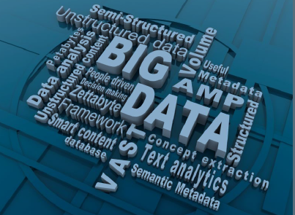
Data Analytics Overview

Slide 4
“We are drowning in information, but starving for knowledge.” John Naisbett Megatrends, 1988 Data Analytics: Data Warehousing, Data Mining, Data Visualization
Notes:
Organizations gather considerable amounts of data on a daily basis:
Supermarket scanners Credit card readers
Automated bank tellers The internet
The volume of data defies manual efforts of analysis and summary (one estimate shows only 5 -7% of collected data are ever revisited)
A major challenge is how to convert expanding data stores into useful knowledge

Slide 5
Data Analytics Overview
Not a new field ...
Since 1990’s referred to as:
Data Analysis, Knowledge Discovery, Data Mining, Data Warehousing
A multidisciplinary field:
Database and data warehousing
Data and model visualization
On-line Analytical Processing (OLAP)
Statistics and machine learning
Knowledge management

Slide 6
Data Analytics Overview
Why has DA become important?
Competitive focus - Knowledge Management
Abundance of data → Big Data !!
Inexpensive, powerful computing systems
Strong theoretical/mathematical foundations
statistics and machine learning
database management systems

Slide 7
Data Analytics Overview
What is Data Analytics?
A Process
The collection and processing of data for:
the identification of novel, accurate, and useful patterns, and
the modeling of real-world phenomenon.
Data Warehousing, Data mining, and Data Visualization are major components.

Slide 8
Data Analytics Overview
What can Data Analytics do for an organization?
Impact on Marketing
Target marketing at a credit card company
Consumer usage analysis at a telecomm provider
Loyalty assessment at a service bureau
Quality of service analysis at an appliance chain
Notes:
A major credit card company able to classify of 10% of customers which account for 40% of positive responses to advertisements
A US telecomm firm has discovered unique market subgroups that reduce service to near zero during specific periods of the year
A service bureau has developed a model for predicting those customers least likely to renew a membership
These examples are particularly relevant to the corporate sponsors

Slide 9
Application Areas Private/Commercial Sector
Marketing: segmentation, product targeting, customer value and retention, ...
Finance: investment support, portfolio management
Banking & Insurance: credit and policy approval
Security: fraud detection, access control
Science and medicine: hypothesis discovery, prediction, classification, diagnosis
Manufacturing: process modeling, quality control, resource allocation
Engineering: pattern recognition, signal processing
Internet: smart search engines, web marketing

Slide 10
Application Areas Public/Gov’t Sector
Finance: investment management, price forecasting
Taxation: adaptive monitoring, fraud detection
Health care: medical diagnosis, risk assessment, cost /quality control
Education: process and quality modeling, resource forecasting
Insurance: worker’s compensation analysis
Security: bomb, iceberg detection
Transportation: simulation and analysis
Statistics: demographic analysis, municipal planning

Slide 11
The Data Mining Process
CRISP-DM
Method
CRoss
Industry
Standard
Process
for
Data
Mining
Developed by employees at SPSS, NCR, DaimlerCrysler

Slide 12
The CRISP-DM Method
Business Understanding:
Establish project objectives and requirements from a business perspective
Convert into a data mining problem definition
Consider model transparency, personal privacy, key input variables, simple approaches
Define the success criteria
Create a detailed project plan.

Slide 13
The CRISP-DM Method
Data Understanding:
Become deeply familiar with sample of data
Discover insights into the data
Identify data quality problems
Detect interesting subsets of data
Create initial Meta Data Report (MDR) - Data about the data (syntax and semantics)

Slide 14
The CRISP-DM Method
Data Preparation:
Construct final dataset used for modeling
Tasks include extraction from raw data (file/table, record, and attribute selection), cleaning, consolidation, and transformation
Tasks performed multiple times iterating with the modeling phase
Update MDR to reflect changes

Slide 15
The CRISP-DM Method
Modeling:
Select and apply modeling techniques
Some techniques may require additional data preparation
Optimize model parameters for best models
Typically, a couple of iterations through the Data Preparation and Modeling phases

Slide 16
The CRISP-DM Method
Evaluation/Interpretation:
Evaluate models against the success criteria using independent data sets (generalization)
Review the steps to construct the model to ensure it properly achieves the objectives
Analyse / interpret model for new found knowledge / understanding
Decide on the use of model/knowledge/results

Slide 17
The CRISP-DM Method
Deployment:
Use of models/knowledge can vary …
As simple as generating a project report
As complex as implementing a repeatable data mining system that is integrate into a larger business process.

Slide 18
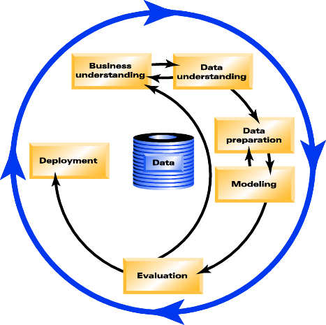
Data Analytics Cycle
Problem
Knowledge
Identify
Problem or
Opportunity
Act on
Knowledge
Measure Effect
of Action
Strategy
Results

Slide 19
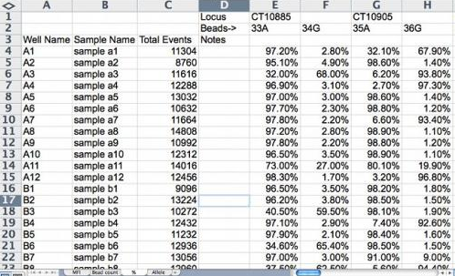
The Data Mining Process
Evaluation &
Interpretation
Visualization
& Modeling
Knowledge
Data Preparation
p(x)=0.02
Data Consolidation
& Warehousing
Patterns &
Models
Data
Warehouse
Prepared Data
Consolidated
Data
Data Sources

Slide 20
The Data Mining Process
Core Problems & Approaches
Problems:
identification of relevant data
representation of data
search for valid pattern or model
Approaches:
top-down deduction by expert
interactive visualization of data/models
bottom-up induction from data
Probability
of sale
Age
Income
OLAP
Data
Mining

Slide 21
The Architecture of a DM System
Graphical User Interface
Data
Preparation
Data
Mining
Evaluation &
Interpretation
Data
Consolidation
Data Sources
Warehouse
Knowledge

Slide 22
The Data Mining Process
Evaluation &
Interpretation
Visualization
& Modeling
Knowledge
Data Preparation
p(x)=0.02
Data Consolidation
& Warehousing
Patterns &
Models
Data
Warehouse
Prepared Data
Consolidated
Data
Data Sources

Slide 23
Data Consolidation & Warehousing
Garbage in Garbage out
The quality of results relates directly to quality of the data
50%-70% of KDD process effort will be spent on data consolidation, cleansing and preprocessing
Major justification for a corporate Data Warehouse

Slide 24
Data Consolidation & Warehousing
From data sources to consolidated data repository
Analysis and
Info Sharing
Operational
DBMS
ETL = Extraction, Transformation, Loading
Data
Warehousing
Legacy
DBMS
Warehouse
or Datamart
Flat Files
Metadata flow
External

Slide 25
Data Consolidation –The Process
Collect & Consolidate
Define requirements - Generate data model
Identify authoritative sources (internal/external)
Extract required data (Prism, Passport, InfoPump)
Integrate into working database (ODS)
Generate meta-data = data about the data
Clean - Measure data quality at the source
Completeness - Accuracy - Integrity (Vality)
Load only clean data into warehouse
Schedule periodic source checking/cleansing
Extract data from outside sources
Transform data to fit operational needs, validate for quality
Loads data into the target data warehouse or data mart

Slide 26
Data Warehouse
A clean, consistent and reliable source of organizational data
Data Warehouse differs from an Operational DB:
subject oriented (products, customers)
integrate data from operational DB
summaries and histories that remain stable
A departmental DW is referred to as a Data Mart
Focus is on local, specific needs
More common than corporate wide data warehouses

Slide 27
Data Warehousing
Definition: The strategic collection, cleansing, and consolidation of organizational data to meet operational, analytical, and communication needs.
75% of early DW projects were not completed
Data warehousing is not a project
It is an on-going set of organizational activities
Must be business benefits driven

Slide 28
Data Warehousing
Common Choices for a Warehouse Repository
RDBMS (Oracle, Sybase, DB2, Red Brick)
supports very large, multipurpose databases
multidimensional access via ROLAP methods
slow for massive/complex data analysis
MDBMS (Accumate, Essbase, Oracle Express)
fast, full feature OLAP
size limitations - 5 GB of raw data (100 GB total)
few standards, proprietary systems

Slide 29
Relationship between DW and DM?
Strategic
Tactical
Rationale
for data
consolidation
Analysis
Query/Reporting
OLAP
Data Mining
Data
Warehousing
Source of
consolidated
data
Notes:
Need to get objectives of each participant.

Slide 30
The Data Mining Process
Evaluation &
Interpretation
Visualization
& Modeling
Knowledge
Data Preparation
p(x)=0.02
Data Consolidation
& Warehousing
Patterns &
Models
Data
Warehouse
Prepared Data
Consolidated
Data
Data Sources

Slide 31
Data Preparation
Generate a set of examples
choose sampling method
consider sample complexity
deal with volume bias issues
Reduce attribute dimensionality
remove redundant and/or correlating attributes
combine attributes (sum, multiply, difference)
Reduce attribute value ranges
group symbolic discrete values
quantize continuous numeric values
OLAP and visualization tools play key role (Han calls this descriptive data mining)

Slide 32
Data Preparation
Transform data
decorrelate and normalize values
map time-series data to static representation
Encode data
representation must be appropriately for the Data Mining tool which will be used
continue to reduce attribute dimensionality where possible without loss of information
OLAP and visualization tools as well as transformation and encoding software

Slide 33
OLAP: On-Line Analytical Processing
OLAP Functionality
Dimension selection
slice & dice
Rotation
allows change in perspective
Filtration
value range selection
Hierarchies
drill-downs to lower levels
roll-ups to higher levels
Profit Values
Sales
Region
OLAP
cube
Year
by Month
Product Class
by Product Name

Slide 34
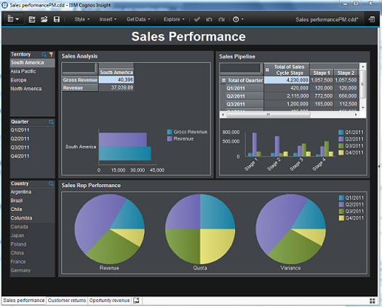
OLAP: On-Line Analytical Processing
IBM
Cognos
Insight

Slide 35
The Data Mining Process
Evaluation &
Interpretation
Visualization
& Modeling
Knowledge
Data Preparation
p(x)=0.02
Data Consolidation
& Warehousing
Patterns &
Models
Data
Warehouse
Prepared Data
Consolidated
Data
Data Sources

Slide 36
Data Visualization
“A picture is worth a thousand words” – Arthur Brisbane [1911]
“The greatest value of a picture is when it forces us to notice what we never expected to see” – John Tukey
“Visual analytics can lead to discoveries that neither a computer nor a human could make alone” – Jean-Daniel Fekete
[slide courtesy of Stan Matwin]

Slide 37
What makes for a good Data Visualization?
Graphical representation of data
View of relationships between data
The right abstraction of the data
Allows us to explore the data
Communicates – Informative
Elegant - Simple
Aesthetically pleasing

Slide 38
Word Clouds

Slide 39
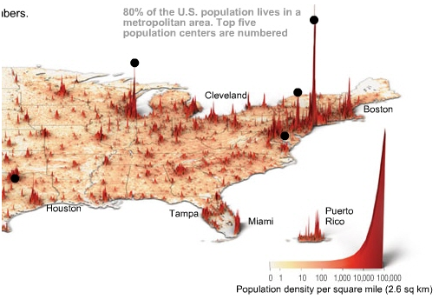
Population of the USA
Source: Time Magazine

Slide 40
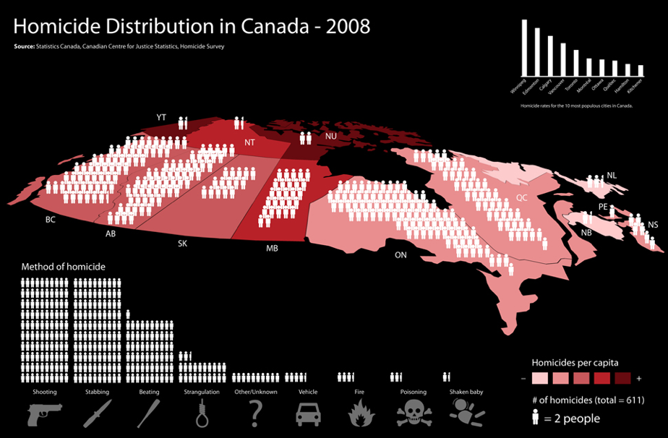
Homicide in Canada

Slide 41
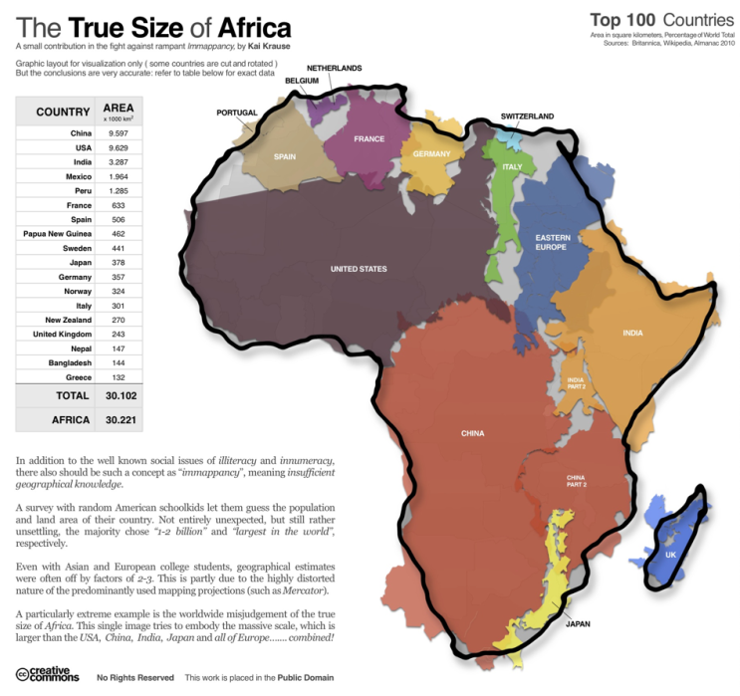
Ture Size of Africa
Source: http://flowingdata.com/2010/10/18/true-size-of-africa/ [Kai Kruse]

Slide 42
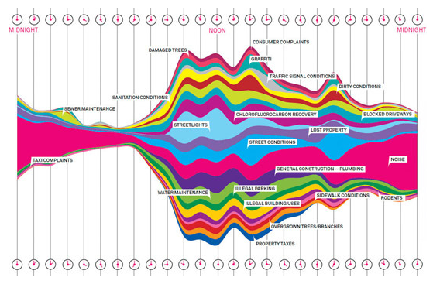
What New Yorkers Complain About
Source: Wired - NY 311, 50,000 calls a day

Slide 43
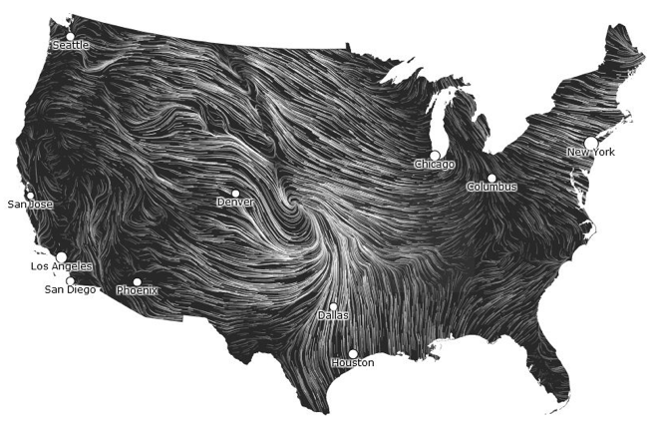
Wind Map
Source: http://hint.fm/wind/ [Martin Wattenberg]
Data from the National Digital Forecast Database

Slide 44
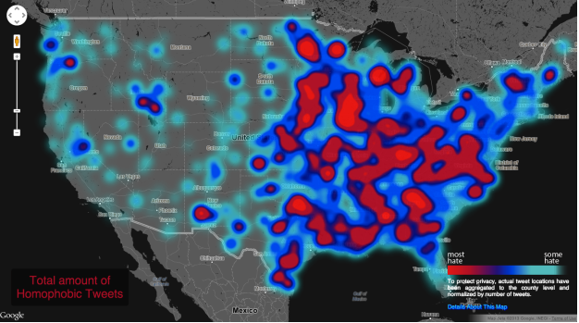
Geography of Hate
Source: http://users.humboldt.edu/mstephens/hate/hate_map.html#

Slide 45
The Data Mining Process
Evaluation &
Interpretation
Visualization
& Modeling
Knowledge
Data Preparation
p(x)=0.02
Data Consolidation
& Warehousing
Patterns &
Models
Data
Warehouse
Prepared Data
Consolidated
Data
Data Sources

Slide 46
Overview of Data Mining Methods
Automated Exploration/Discovery
e.g.. discovering new market segments
distance and probabilistic clustering algorithms
Prediction/Classification
e.g.. forecasting gross sales given current factors
regression, neural networks, genetic algorithms
Explanation/Description
e.g.. characterizing customers by demographics and purchase history
inductive decision trees, association rule systems
Age
Income
$(w)
w
if age > 35
and income < $35k
then ...
Focus is on induction of a model
from specific examples
Notes:
At the university, the corporate sponsors and within the greater business community ...
Research
Investigate and advance state-of-the art KDD technologies and processes and their application to marketing information
Application
Identify problems and apply appropriate KDD technologies and processes
Facilitate project management though the transfer of success factors
Promotion and Resource
Act as a catalyst and resource on KDD
Publish research and case study results
Establish Atlantic Canada as a leader
Education
Develop and deliver KDD seminar material at the academic and industry level

Slide 47
Data Mining Methods
Automated Exploration and Discovery
Distance-based numerical clustering
metric grouping of examples (KNN)
graphical visualization can be used
Bayesian clustering
search for the number of classes which result in best fit of a probability distribution to the data
Unsupervised Learning
Income
Age

Slide 48
Data Mining Methods
Prediction and Classification
Function approximation (curve fitting)
Classification (pattern recognition)
Methods:
Statistical regression
Artificial neural networks
Genetic algorithms
Nearest neighbour algorithms
Supervised Learning
f(x)
x
A
B
x2
x1
O1
O2
I1
I2
I3
I4

Slide 49
Data Mining Methods
Generalization
The objective of learning is to achieve good generalization to new cases, otherwise just use a look-up table.
Generalization can be defined as a mathematical interpolation or regression over a set of training points:
f(x)
x

Slide 50
Data Mining Methods
Generalization
Generalization accuracy can be guaranteed for a specified confidence level given sufficient number of examples
Models can be validated with a previously unseen test set or approximated by cross-validation methods
f(x)
x

Slide 51
Classification
1
Y
Logistic Regression
0
Y=f(M,T)
Y
B
B
B
B
B
B
B
B
B
B
M
T
B
A
B
A
B
B
Mistakes
B
B
B
A
B
A
B
B
A
A
B
A
B
A
A
B
B
B
B
A
A
A
A
A
A
B
A
A
B
A
A
B
A
Typing Speed

Slide 52
Classification
Artificial Neural Network
Y
B
B
B
…
B
B
B
B
B
B
B
B
A
B
A
B
B
M
T
Mistakes
B
B
B
A
B
A
B
B
A
A
B
A
B
A
A
B
B
B
B
A
A
A
A
A
A
B
A
A
A
B
A
A
B
A
Typing Speed

Slide 53
Classification
k Nearest Neighbour
B
B
Classification is based
on majority vote of
nearest neighbours.
B
B
B
B
B
B
B
B
B
A
B
A
B
B
Mistakes
B
B
B
A
B
A
B
B
A
A
B
A
B
A
A
B
B
B
B
A
A
A
A
A
A
B
A
A
A
B
A
A
B
A
Typing Speed

Slide 54
Data Mining Methods
Explanation and Description
Learn a generalized hypothesis (model) from selected data
Description/Interpretation of model provides new human knowledge
Methods:
Inductive decision tree and rule systems
Association rule systems
Link Analysis
A?
Root
B?
C?
D?
Yes
Leaf

Slide 55
Classification
Root
M?
T?
T?
Inductive Decision Tree
B
A
Leaf
B
B
B
B
B
B
B
B
B
B
B
A
B
A
B
B
Mistakes
B
B
B
A
B
A
B
B
A
A
B
A
B
A
A
B
B
B
B
A
A
A
A
A
A
B
A
A
A
B
A
A
B
A
Typing Speed
Blood Pressure Example

Slide 56
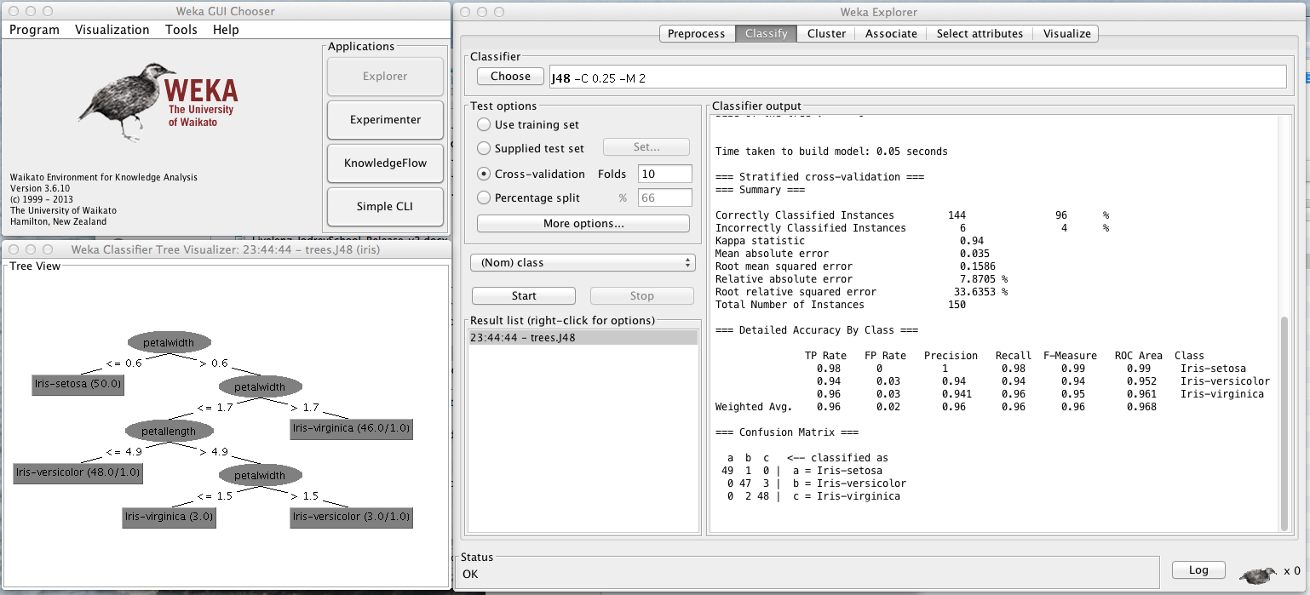
Data Mining Methods WEKA – A Data Mining Environment

Slide 57
The Data Mining Process
Evaluation &
Interpretation
Visualization
& Modeling
Knowledge
Data Preparation
p(x)=0.02
Data Consolidation
& Warehousing
Patterns &
Models
Data
Warehouse
Prepared Data
Consolidated
Data
Data Sources

Slide 58
Interpretation and Evaluation
Evaluation
Statistical validation and significance testing
Qualitative review by experts in the field
Pilot surveys to evaluate model accuracy
Interpretation
Inductive tree and rule models can be read directly
Clustering results can be graphed and tabled
Code can be automatically generated by some systems (ANNs, IDTs, Regression models)

Slide 59
Interpretation and Evaluation
Visualization tools can be very helpful:
sensitivity analysis (I/O relationship)
histograms of value distributions
time-series plots and animation
requires training and practice
Quality(V,T)
Temp
Velocity

Slide 60
Important Trends
Notes:
Organizations gather considerable amounts of data on a daily basis:
Supermarket scanners Credit card readers
Automated bank tellers The internet
The volume of data defies manual efforts of analysis and summary (one estimate shows only 5 -7% of collected data are ever revisited)
A major challenge is how to convert expanding data stores into useful knowledge

Slide 61
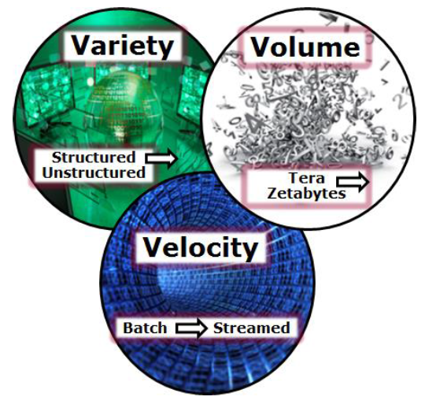
What makes Big Data – Big”

Slide 62
Big Data Analytics Outlook
General Electric (GE) gained around $45bn in additional revenue in 2012 by using Big Data Analytics, according to CEO Jeff Immelt. The business benefits of Big Data Analytics are now undeniable
Substantial paybacks continue to be proven. Global spending on Big Data exceede $31bn in 2013.
Expect that figure to reach $114bn in 2018.
Backing that prognosis, New Vantage Partners’ 2013 Big Data Executive Survey revealed that 91% of its respondents, from Fortune 1000 companies, already had a Big Data initiative planned or in progress. In a global survey of some 720 of its Gartner Research Circle members, Gartner found that 64% were investing or planning to invest in Big Data technologies, up from 58% in 2012.
http://www.yellowfinbi.com/YFCommunityNews-If-the-benefits-of-Big-Data-Analytics-are-indisputable-why-are-many-struggling-t-151123

Slide 63
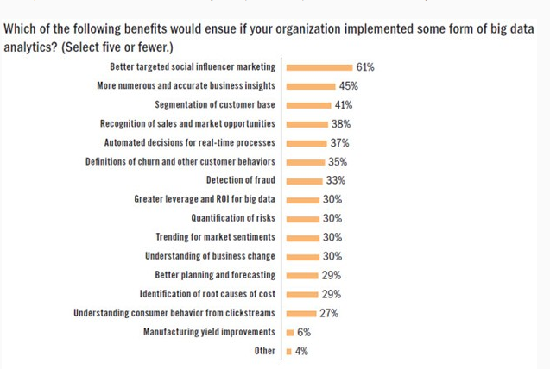
Benefits of Big Data Analytics?
Research conduct by Avanade, found that 84% of organizations actively leveraging Big Data claim they can now make better decisions as a direct result. In isolation, these findings would be susceptible to ridicule. However, many comparable reports tell a similar story. Based on 1635 responses from 325 respondents.

Slide 64
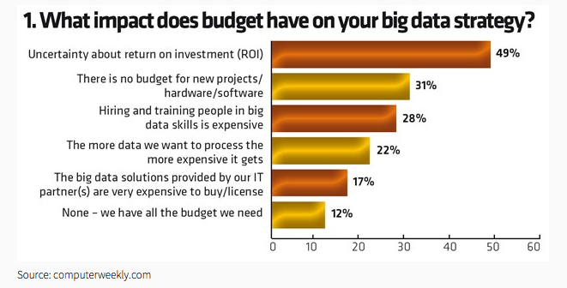
Despite the potential benefits, many organizations feel overwhelmed.
A recent Bain & Company study, examining more than 400 large organizations with Big Data aspirations, found that only 23% had a clear strategy for effectively using Big Data Analytics. Only 18% of respondents to the abovementioned CompTIA survey agreed that they were “exactly where they wanted to be in managing and using data”.

Slide 65
Requirements and Costs of KDD
Hardware - cloud based, affordable
Software - integrated suites (open source, IBM, SAS)
Data – internal operational, external sources, surveys
Human resources
DB/DP/DC expertise to consolidate/prepare data
Data Scientist
Business Intelligence / Domain expertise
Project management
70% of the effort is expended on the data consolidation and preparation activities

Slide 66
Current Trends
Data Visualization will democratize access to data and foster a strong data analysis culture ➔ self-service Business Intelligence
Collecting and analyzing mobile device data
Analytics in the Cloud - computing platforms (Amazon Web Services, Microsoft Azure, RedShift) will enable scalable, fast, and secure solutions at affordable prices.
Predictive Analytics Takes Center Stage
Hadoop-based reliable high performance computing will gain stature
Internet of Things – early focus on smart watches, activity monitors, wearables
Data privacy and security concerns will grow
Smarter apps that use personal data that learn and improve with experience
Use of unstructured external data (social media) will continue to be important
Investment in big data analytics will rise (Chief Data Officers = CDOs)

Slide 67
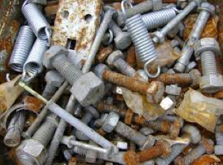
Unstructured Data
Definition: Information that either does not have a pre-defined data model or is not organized in a predefined manner
Imprecise for several reasons:
Structure of data may be easily implied, but not explicit
Data may have explicitly structure but not for the task at hand
Data may have some underlying structure that is not understood

Slide 68
80% of Data is Unstructured
Much of it is text based:
Business data:
Call center transcripts
Other CRM
Email
Open-ended survey responses
Web pages
NewsGroups
Organizational documents
Regulatory information
Notes:
It’s been estimated that 80% of the data in an organization is an unstructured format, that is, in the form of documents, HTML pages, database notes, email, open-ended survey responses, etc. This fact means that decision-makers often rely on only 20% of the data available and a little bit of the documents that they can read.
Take open-ended surveys, for example: cross-tab reports of responses are common but open-ended responses, which hold valuable information which qualify the responses and bring up new themes. Organizations rarely have the tools or the time to truly process and disseminate this important information. In a similar fashion, database notes on customer contacts are effectively used to manage individual contacts, but this valuable source of customer information is never used to really understand the customer experience overall. What if you could use this information to keep and grow customers to increase customer lifetime value?

Slide 69
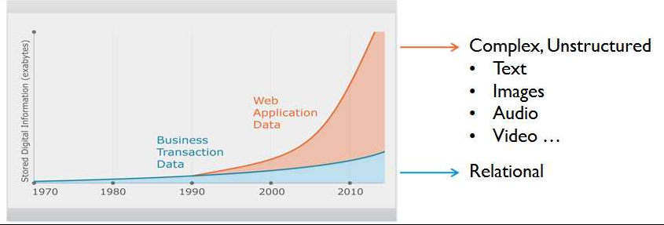
Growth of Unstructured Data

Slide 70
Examples of Information Filtering
News filtering
Email filtering
Recommending Systems
Literature alert
And many others

Slide 71
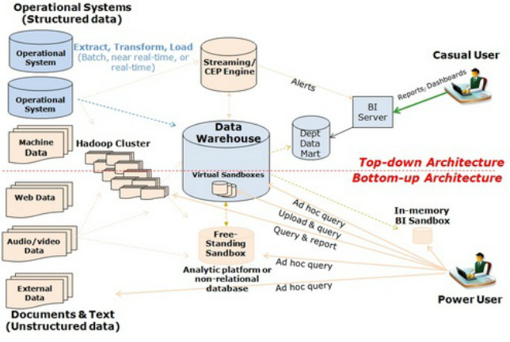
Top-Down – traditional DA Architecture Bottom-up – Big DA Architecture

Slide 72
Current Management Issues
Ownership of data and knowledge
Security of customer data
Responsibility for accuracy of information
Ethical practices - fair use of data

Slide 73
THE END danny.silver@acadiau.ca

Slide 74
Marketing Embraces KM, DW, DM
Why? …
Relationship
Marketing
a.k.a
Customer Relationship Management
Marketing
Traditional
Marketing
MIS
Data
Warehousing
Data Mining
Notes:
Need to get objectives of each participant.

Slide 75
What is Relationship Marketing?
Knowing your customers on an individual basis
Maximizing life-time value not individual sales
Developing and maintaining a mutually beneficial relationship
Acquire, retain, win-back desirable customers
Arbuckle’s
Market
“ The Corner Store ”

Slide 76
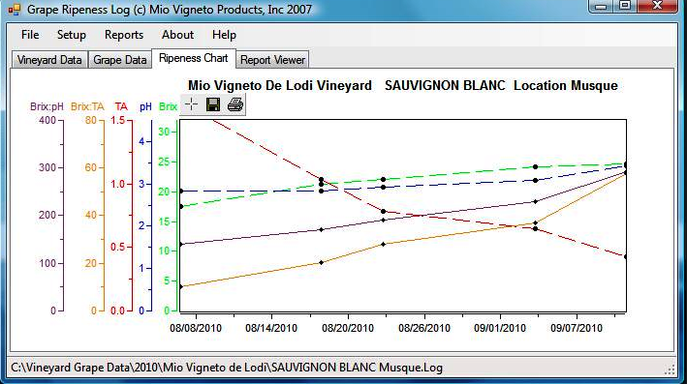
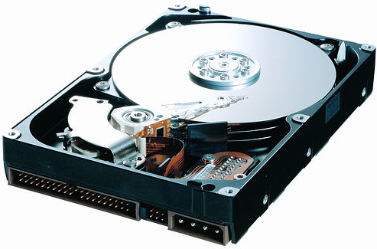
Data Analytics
Knowledge
Data Mining
& Visualization
Data Preparation
Data Collection

