Slide 1
Organizational & Individual Competitiveness Through “Whole-Person Engagement”
Gail Godreau MBA, CCP
Wellness Consultant, Coach & Speaker
April 2014
Notes:
Hello everyone! My name is Gail Godreau and I own Lighthouse Wellness Strategies – a company which provides Wellness Coaching, Navigation and Consulting services. I’m looking forward to sharing with you some thoughts on Work-Life Balance and Its Connection to Workplace Wellness.
What I hope to share with you in our short time together this afternoon is a bit about:
What Wellness Is
Why it Matters to You AND your Organization
How Work-Life Balance and Workplace Wellness are inextricably connected
Some thoughts on the STRATEGIC business benefits of Workplace Wellness Initiatives and Programs, and some sample Program elements
Why it is CRUCIAL, particularly at this point in time, that we do things DIFFERENTLY in our workplaces, in order to continue to compete and to THRIVE!
We will have some time at the end for Questions and Answers and I’d be happy to chat with you individually at the end if that’s better for you.
How does that sound?
--

Slide 2
“Work-Life Balance”
Overly simplistic
Hard to Achieve

Slide 3
What Is “Wellness”?
Not simply “the absence of illness or disease”
“A healthy balance of the mind, body and spirit that results in an overall feeling of well-being”
Notes:
taking “work-life balance” to a whole new level!
--

Slide 4
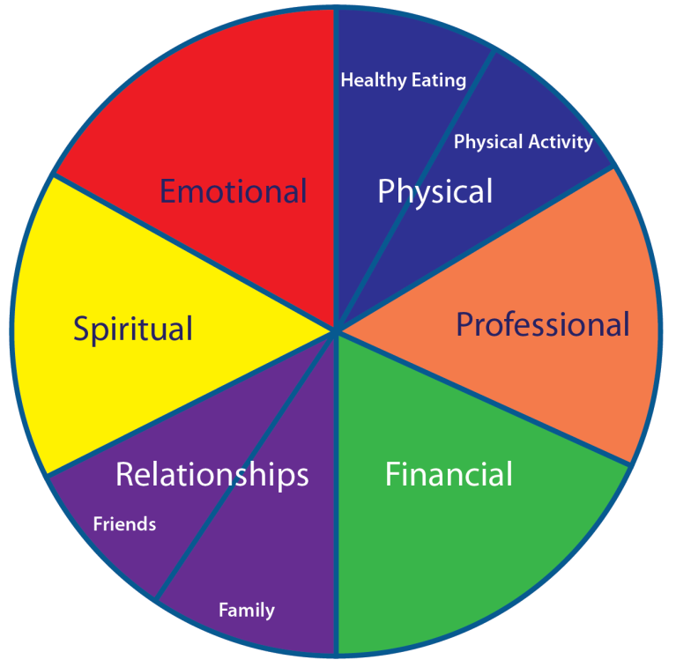
“Whole-Life Wellness”
What it is – broader, considers WHOLE person
Why it matters – multi-dimensional, integrated
Notes:
We are MORE than our role.
Wellness in various segments of Wheel CONTRIBUTE to Professional Wellness (and vice versa).
NOT 2-dimensional; ‘chasing our tail’
In Full-Day Workshop, would talk about: Benchmark, Strategies/Tactics to advance; Coaching if needed; check-in for progress/tweaking

Slide 5
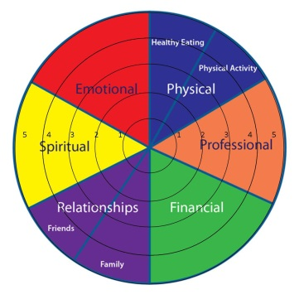
How are YOU doing?
1=TERRIBLE 5= GREAT!

Slide 6
An Example…

Slide 7
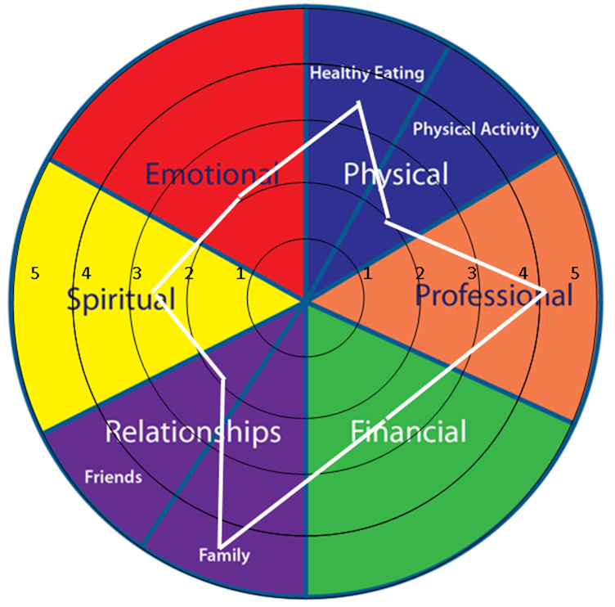
The GOAL(s)
Bigger = more
Rounder = same direction
Balance (‘mostly’)
Progress, not Perfection
“Balanced Abundance”
Notes:
GOAL(s) [fade in]
(audience fill in): Balance ‘mostly’ - Progress, not Perfection
FULL-DAY WORKSHOP to go through & ID Action Plan

Slide 8
“Whole-Person Engagement”
Making conscious CHOICES in each area of the Wellness Wheel
Actively PARTICIPATING in each area
Living with INTENTION (not by default)
Bringing WHOLE SELF to various areas of life
Integrating
Notes:
My Story: Dal, felt had to leave part of my SELF at home (ignore it)

Slide 9
Why it Matters
Employee (Individual)
Employer (Organization)
Economy (Community)
THRIVE!
Notes:
[ANNIMATE ‘THRIVE’]
Employee / Individual (my story)

Slide 10
Individual Benefits
Energy
Mental clarity & focus
Creativity
Resilience
Ability to recognize/create/seize opportunities!

Slide 11
Do Organizations Benefit – REALLY?
What do you THINK?
What do you KNOW?
HOW do you know? (ROI?0 Other?)
Can we demonstrate ROI? Why/why not?
Where else do you measure impact?
Notes:
My Study
Local data (NS so far)*
No real sense of minimum ROI needed
Don’t tend to measure ROI
CBOC: very FEW org’ns even measure ATTENDANCE!
Interested in learning more re. study, contact me
QUESTIONS:
How many of you THINK/believe Workplace Wellness Programs & Initiatives are a smart business decision?
How many of you KNOW they are?
How many of you need to justify the ROI of such programs & initiatives? To yourself? To someone else?
What would you say is the MINIMUM ROI you would need in order to proceed?
10? 5? 3? 2? 1.5? Anything over 1?
Do you provide the following:
Casual days
Employee pension plans with employer co-pay
Birthday cakes
Holiday and/or summer staff parties/events
Team-building retreats/workshops
Other…
Do you KNOW the ROI on these?
Do you REQUIRE a certain ROI? If so, what?
Why/not?
If NOT, why do you do them?
My own STUDY of NS organizations (to get local data):
No real sense of minimum ROI needed
Don’t tend to measure ROI
CBOC: very FEW org’ns even measure ATTENDANCE! (3%?)
Still provide initiatives; still confident in their benefits
(Want to participate and/or receive summary report of findings, speak to me at end/note on biz card and give to me)
Challenges:
Lack of benchmark data (so can’t demonstrate ROI, even if it’s there)
Some data is subjective (ex. Morale)

Slide 12
Strategic Benefits of Workplace Wellness
Well Organizations Do Better!
* CBOC 2012 at Better Workplace Conference 2013
LESS: | MORE:
Absenteeism = more time at work (costs Canada $16.6 billion/yr*) | Employee engagement
“Presenteeism” = more productivity while at work | Reputation as “Employer of Choice”
Retraining costs | Customer confidence
 | Competitiveness & sustainability
 | Profitability / Efficiency!
‘Discretionary effort’ -> ‘A-game’
Notes:
Smart businesses and organizations are investing in the Wellness of their employees! They are the leaders in the local economy.

Slide 13
Sun Life ̶ Ivey Canadian Wellness ROI Study
Absenteeism reduction alone
Save 1.5-1.7 days absenteeism /employee/yr
→14%-36% reduction
→save Cdn economy $3.6 BILLION /yr
PLUS additional benefits:
productivity
employee health
drug cost claims
health costs, etc.
Notes:
Absenteeism: just ONE ‘SYMPTOM’ of disengagement/lack of wellness
Ivany Report (NS) – STERN Warnings!...
Ivey: save 1.5-1.7 days absenteeism /ee/yr. Based on avg of 4.7-11.2 days absent /yr in Canada (SOURCE: Stats Can 2011) → 14%-36% reduction
[if $30,000/yr ee
Using avg # workdays/yr of 260
X# work days/yr = xx/day; /day rate x 1.5 (to 1.7) days/yr=cost (for that ee only; not counting replacement, missed opportunities, etc.)
260 work days for $30K, so 30,000/260=115.38/day
Absenteeism costing (1.5 x 115.38) to (1.7x115.38), or 173.07 to 196.15 /ee/yr]
GHP Index 2013 data:
average income per capita in Halifax and St. John’s (only Atl. Can. Cities in report) approx. $40,000
absence rates of full-time employees (days lost to illness, disability, personal or family responsibility per year) 10.2 Hfx, 10.4 St. John’s (9.3 Canada) so is on upper end of Stats Can range and would cause HIGHER impact than per CBOC data (below)
CBOC data (Sept. 2013):
Direct cost of absenteeism to the Canadian economy was $16.6 billion in 2012
Employees were absent an average of 9.3 days in 2011
Ivey conclusion: wellness could reduce absenteeism → save Cdn economy $3.6 BILLION /yr
Likely INDICATIONS of additional positive benefits re. ROI, productivity, employee
health, drug cost claims, health costs, etc. (study continuing)
‘wellness program’ (SunLife model) included:
Web portal
Wellness survey
Bio-metric screening
Cardiovascular screening clinics
Health coaching
Education sessions
Health challenges
Online lifestyle modification programs
CONCLUSIONS of SunLife-Ivey Study:
“Considerable anecdotal and case-based information that suggests a host of positive outcomes from Wellness Programs”
“Tremendous potential for valuable outcomes for individuals, organizations and society from workplace wellness programs”
[SOURCE: Sun Life ̶ Ivey Canadian Wellness ROI Study, Presented by Michael Rouse, PhD (Ivey School of Business) at Better Workplace Conference, Halifax 2013]
Costs…
Benefits…
We CAN’T AFFORD to WAIT!
‘sitting is the new smoking’ – recent study(ies) – DANGERS!!...SEE

Slide 14
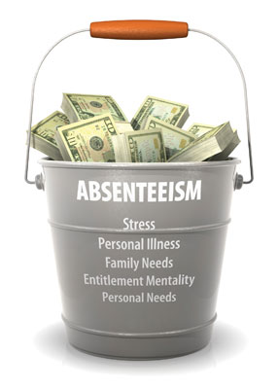
Greater Halifax Partnership Data
Avg. income per capita (Halifax) ~ $40,000 Absence rates (/f-t employee) = 10.2 days/yr
→COST = $1,584.62 per employee per year
How many employees do YOU have?...
Notes:
GHP: Halifax and St. John’s (only Atl. Can. Cities in report)
Broader benefit to Economy/Community
Absence rates of full-time employees = 10.2 days /employee/yr
→cost: $40,000/260 days = 153.85 /day
times 10.2 days = $1,584.62 /employee/yr

Slide 15
But Wait…It Gets Even BETTER!
Knowledge Workers in NS:
Average income $54,356.25
Cost of absenteeism $2,132.44 per year
Notes:
Based on the following occupations:
Computer Programmers and Interactive Media Developers
Database Analysts and Data Administrators
Information Systems Analysts and Consultants
Software Engineers
SOURCE: Lbr Mkt Info http://careers.novascotia.ca/compareoccupations

Slide 16
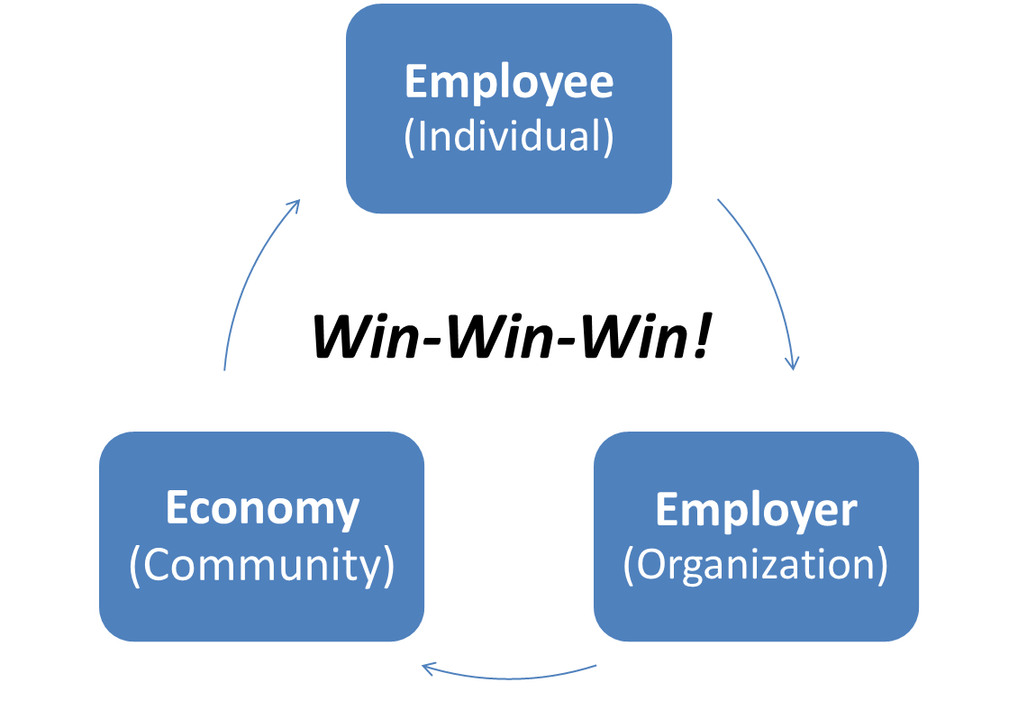
Sun Life ̶ Ivey Canadian Wellness ROI Study - Conclusion
“…tremendous potential for valuable outcomes for individuals, organizations and society from workplace wellness programs”

Slide 17
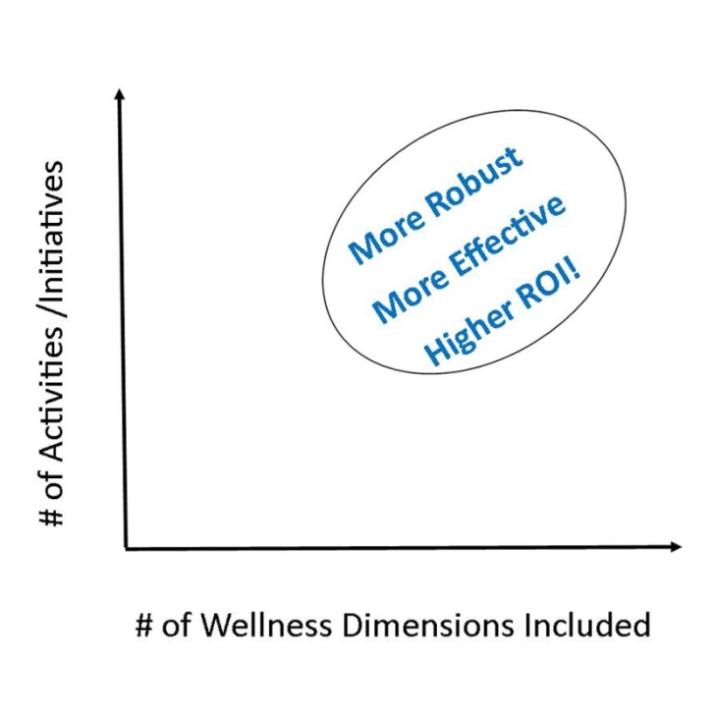
Workplace Wellness Initiatives – Examples
Information
Support
Role Model
Manage Expectations
Policies & Practices
Notes:
Employer – ‘facilitate’ wellness of ee; infrastructure; role model/walk the talk; WIIFM
Ex. Don’t set up initiatives, then make it difficult to participate
Ex. Don’t advocate one thing and do another (culture; all levels; be SEEN to be participating, not just endorsing or paying for)
Ex. Don’t just ‘throw spaghetti at the wall & see what sticks’ – assess, implement, evaluate, re-assess, revise, etc.
→ DO’s (reverse of above)
Have huge opportunity to influence/enable/facilitate wellness behaviours
IDEAL to include FAMILIES where possible – support, greater chance of success!

Slide 18
“Workplace Wellness”
Continuum…
Assumption: more comprehensive, holistic approach and longer-term (not one-off’s)
IDEAL: addresses all 6 main (8 sub) Dimensions of Wellness
Notes:
Number of Workplace Wellness initiatives address only the Physical (PA or HE); and some pull us in competing directions… (ex. Fitness colleague)

Slide 19
Our Own Workplace Wellness Study: Preliminary Results
Best Practices – variety; consistency; repetition
Benefits – ‘suspected’ vs. absolutely KNOWN
Challenges – measurement / quantification; middle-management support
Notes:
Preliminary Results…Still Opportunity to be part of STUDY
Best Practices – variety of programs; consistency; repetition
Benefits – varied; ‘suspected’ vs. absolutely KNOWN
Challenges – measurement/quantification; middle-management support

Slide 20
Where Do Your Employees Fit on the Company Balance Sheet?
LIABILITIES
To be minimized
ASSETS
To be leveraged

Slide 21
Ivany Report – 2014 *
“The Commission has concluded that the economic and population challenges we now face…demand new vision, innovative approaches, greater collaboration and a greater willingness to take on the risks associated with economic change and progress.”
* Source: Now or Never: An Urgent Call to Action, for Nova Scotians, Feb. 2014
Notes:
WARNING!

Slide 22
Ivany Report – 2014 *
“[T]he successful pursuit of the proposed goals will require much more effective and efficient deployment of current resources combined with changes in attitudes, policies, and practices across all business, government, and community sectors.”
* Source: Now or Never: An Urgent Call to Action, for Nova Scotians, Feb. 2014
Notes:
WARNING!

Slide 23
Better Workplace Conference October 2013
“The only sustainable source of competitive advantage is being able to outlearn your competitors (that is, your people)”
~ Dr. Michael Rouse, PhD (Ivey School of Business)
Notes:
At Better Workplace Conference, October 2013

Slide 24
Who Is Responsible?
Employee – personal accountability, ownership
Employer – facilitate healthy choices
Community – support, infrastructure
Government(s) – policies, laws, economic support

Slide 25
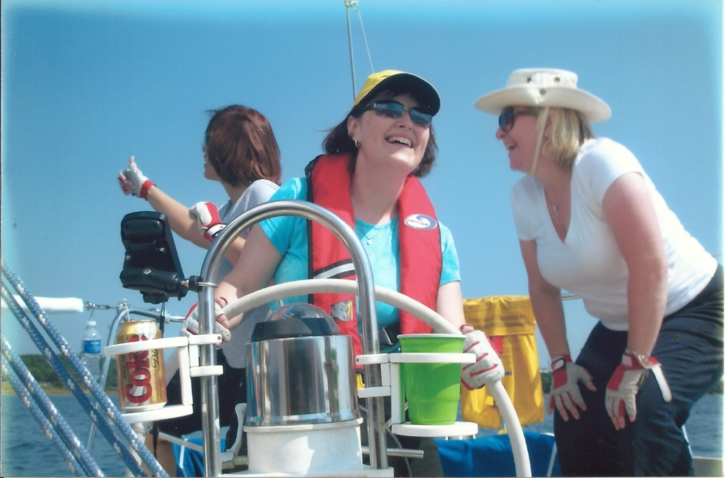
Employee’s Responsibility
Steering the Ship…
Ownership
Choice
Notes:
[GRAPHIC: me steering sailboat?] – can listen to input from others but YOU’re ‘steering the ship’
Employee – ultimate ‘ownership’ of own wellness; negotiate/manage expectations; WIIFM; don’t wait for ‘they’

Slide 26
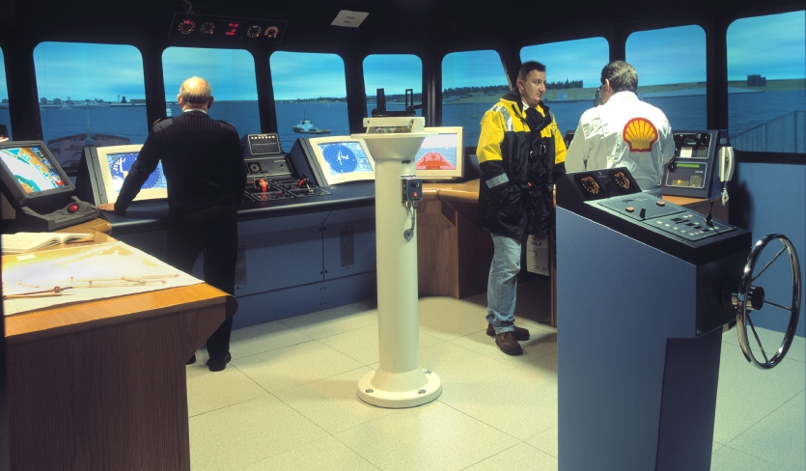
Employer’s Responsibility
Facilitating the voyage (significant role of work in our lives)
Equipment
Charts/maps
Crew (on ship and on shore)
Leadership
Time (‘shore-leave’)

Slide 27
Employer’s Responsibility
“Family-Friendly” → “Life-Friendly” (WHOLE person)

Slide 28
Contact Me
E-mail: gail@lighthousewellness.ca
Phone: (902) 471-6729
Website: www.lighthousewellness.ca
“Helping Organizations THRIVE by
Helping their People THRIVE!”
Speaking  Workshops  Consulting  Coaching
Notes:
Biz Card for Sample TIP SHEET for Employee & Employer Responsibilities and a Printable POSTER for [LINK back to website to D/L?]

Slide 29
Thank You!
Questions? Comments?

