Slide 1
“Who Wants To be a Millionaire ? ”
The Lean Startup Model & The Startup Life Cycle

Slide 2
Lean Startup - Prizes
Business Cards:- Names + e-Mail to get a copy of this Presentation
Business Model Generation :- By Alexander Osterwalder & Yves Pigneur
The Startup Owners Manual ;- By Steve Blank & Bob Dorf
The Lean Startup :- By Eric Reis

Slide 3
“Who Wants To be a Millionaire ? ”
The Lean Startup Model & The Startup Life Cycle

Slide 4
“Introduction to C-Level Execs ”
Startup less than 1 yr old
Group of 30 individuals – Executive positions
Mission – 1) To assist existing SMB to compete
in a global marketplace 2) Support Creation of
new entrants to SMB - “ Startups”
Research – SMB market is under Duress
NS lost 25% of Manufacturing Jobs in last 7 yrs

Slide 5
Canada- Nation of Entrepreneurs
GEM – Global Entrepreneurship Monitor 2013
28 countries in Innovation Driven Economies
Canada ranked 2nd at 12.2 % ( US #1 at 12.7%)
(Working age people in companies < 3.5 yrs)
50 % of people believe they have the knowledge and skills to be entrepreneurs
37% are afraid of Failure

Slide 6
The ICT Sector In Nova Scotia
The ICT sector accounted for 1.5 B OF NS GDP
The industry is growing faster than any other sector in the province
50% larger than (Agriculture+Forestry+Fishing)
The province graduates 16% more ICT students per capita than the national average.
The ICT sector employs about 15,000 people with 70% located in Halifax.

Slide 7
“Challenge to the ICT Members”
Are you an Entrepreneur?
Do you have an idea or concept that is unique ?
Are you prepared to learn the Tools / Techniques of creating a startup business model?
Do you have the strength of character to learn by failing ? “ Validated Learning”

Slide 8
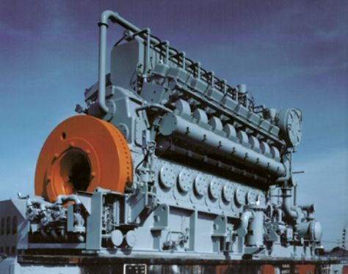
Who or What is an Entrepreneur
Entrepreneur;- A person who organizes and manages any enterprise usually with considerable initiative and risk
Entrepreneurship:- Is business management skills under extreme conditions of uncertainty, with no customers, no product, and not knowing if it will work
Economic Engine
for Growth

Slide 9
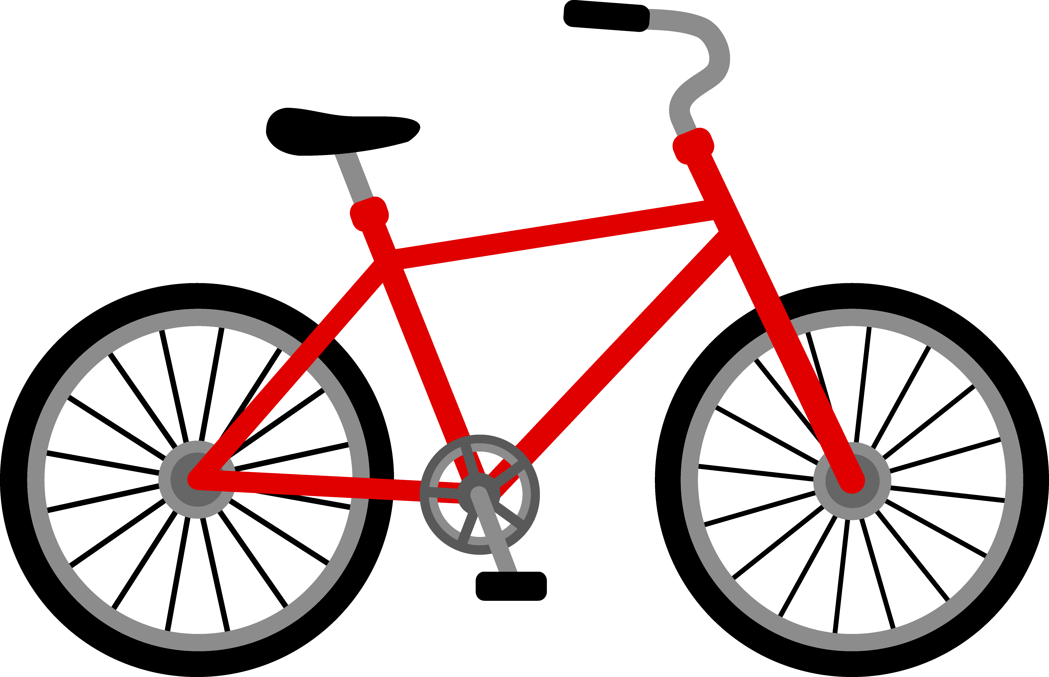
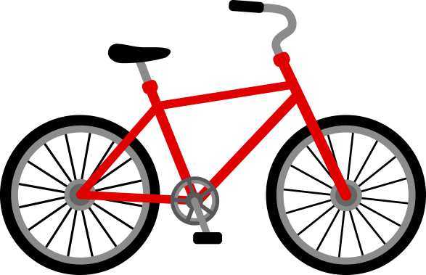
Entrepreneurship A Learned Behavior-Can it be Taught
YES
NO
Validated Learning
Back Wheel :-
Tools and Techniques
Front Wheel :-
Personal Attributes
Integrity – Trust
Passion - Commitment
Energy- Work Ethic
Perseverance
Focus on the Objective
Innovation – Creativity
Teamwork - Positive People
Lean Startup Model
Artists
Musicians
Athletes
Project Managers

Slide 10
Lean Startup Model

Slide 11
Where did this Lean Startup Model Concept Come From??
Steve Blank – “The Four Steps to the Epiphany”
A Startup is NOT a smaller version of a larger company and large company management practices are ill suited for a startup.
A Business Model describes how a company creates,
delivers and captures value. It’s how a company makes Money
A Startup is a temporary organization in Search of a scalable, repeatable, profitable Business Model
A large organization focuses on execution of it business model to generate profits for its stakeholders

Slide 12
Components of a Lean Startup Model
Ideation- Concept of a unique Product - Service
Business Model Canvas
Value Proposition Canvas
Customer Development “Get Outside of the Building”
Agile Model for Product -Technology Development
Minimum Viable Product - MPV
Pivot
Product / Market Fit
Innovation Accounting - Product Viability

Slide 13
Ideation
Invention Risk :- Success depends on the team creating a critical technology advance that is beyond just engineering – “Breakthrough”
The timeline and the funds required to accomplish this goal are very High Risk – High Rewards LASIK
Market Risk:- Lean Startup Model attempts to reduce market risk upfront by creating a structured process (using BM Canvas, Customer Development and Engineering/ Agile techniques) to arrive at Product Market Fit – Then Scale UP - Quickly
Difference:- Focus on executing the model vs is it technically possible or feasible

Slide 14
Business Model Canvas Explained
How can you
describe your
Business Model?

Slide 15
Business Model Canvas
Key Partners | Key Activities | Value Propositions |  | Customer Relationships | Customer Segments
Who are our key partners? | What key activities do our value props require? | What value do we deliver to the customer? |  | How do we get, keep, and grow customers? | For whom are we creating value?
Who are our key suppliers? | Our distribution channels? | Which one of our customers' problems are we helping to solve? |  | Which customer relationships have we established? | Who are our most important customers?
Which key resources are we acquiring from our partners? | Customer relationships? | What bundles of products and services are we offering to each segment? |  | How are they integrated with the rest of our business model? | What are the customer archetypes?
Which key activities do partners perform? | Revenue streams? | Which customer needs are we satisfying? |  | How costly are they?
 |  | What is the minimum viable product?
 | Key Resources |  |  | Channels
 | What key resources do our value proposition require? |  |  | Through which channels do our customer segments want to be reached?
 | Our distribution channels? |  |  | How do other companies reach them now?
 | Customer relationships? |  |  | Which ones work best?
 | Revenue streams? |  |  | Which ones are most cost-efficient?
 |  |  |  | How are we integrating them with customer routines?
Cost Structure |  |  | Revenue Streams
What are the most important costs inherent to our business model? |  |  | For what value are our customers really willing to pay?
Which key resources are most expensive? |  |  | For what do they currently pay?
Which key activities are most expensive? |  |  | What is the revenue model?
 |  |  | What are the pricing tactics?
7
1
4
8
2
6
3
9
5
10
Competition / Alternatives
11
Size of the Market (Units -Rev $$ -Profits $$)

Slide 16
Business Model Optimization
Key Partners | Key Activities | Value Propositions |  | Customer Relationships | Customer Segments
 | Key Resources |  |  | Channels
Cost Structure |  |  | Revenue Streams
Key Partners | Key Activities | Value Propositions |  | Customer Relationships | Customer Segments
 | Key Resources |  |  | Channels
Cost Structure |  |  | Revenue Streams
Key Partners | Key Activities | Value Propositions |  | Customer Relationships | Customer Segments
 | Key Resources |  |  | Channels
Cost Structure |  |  | Revenue Streams
Key Partners | Key Activities | Value Propositions |  | Customer Relationships | Customer Segments
 | Key Resources |  |  | Channels
Cost Structure |  |  | Revenue Streams
Key Partners | Key Activities | Value Propositions |  | Customer Relationships | Customer Segments
 | Key Resources |  |  | Channels
Cost Structure |  |  | Revenue Streams
Rigorous Validation Of Model Assumptions
The “Best” Model

Slide 17
Value Proposition Canvas
Value Proposition
6
1
Customer Segment
Gain
Creators
7
Gains
4
Products
& Services
9
2
Customer Job(s)
3
8
Pain
Relievers
Pains
10
5

Slide 18
Value Proposition Canvas
Value Proposition
Customer Segment
Gain
Creators
Gains
Products
& Services
Customer Job(s)
Pain
Relievers
Pains

Slide 19
Scalable Startup - Customer Development
Search
Execute
Customer Discovery
Customer Validation
Customer Creation
Scale Company
Pivot
Early
Adopters
Market
Majority
Visionaries

Slide 20
Scalable Startup – Agile Development
Minimum Viable product - MVP
User Stories
Test Scenarios
Requirements
Bugs
Latest Version
Small Releases
MVP
Architectural Spike
Release Planning
Iteration
Acceptance Tests
Spike
Next Iteration
Agile Development XP – Extreme Programming
Rapid Iterations- People centric- Continuous Feedback

Slide 21
Scalable Startup
Customer Discovery
Customer Validation
Customer Creation
Scale Company
Hypotheses
Experiments
Insights
Data
Feedback
Insights
Minimum
Viable Product MVP
User Stories
Test Scenarios
Requirements
Bugs
Small Releases
MVP
Product / Market Fit
Architectural Spike
Release Planning
Latest Version
Acceptance Tests
Iteration
Next Iteration
Spike

Slide 22
Pivot
A pivot generates a change in the business strategy and needs
to be fact based, utilizing metrics, and rigorous testing
Zoom In: Single feature becomes the product
Zoom out: Product is expanded to cover new needs
Customer Segment: product solves need of new segment
Customer Need: Original discarded new need is identified
Business Architecture: HM-LV switches to HV-LM or reverse
Technology Pivot: Solve need using different lost cost technology solution

Slide 23
Pivot Case Study
Smart Skin Technologies: In 2008 technology called Quantifeel
Developed by CEO Kurmaran Thillainadarajah at UNB. It can detect pressure on a surface and chart the pressure in
real time on a device.
Investors: RHO, Build Ventures. Growth Works, NBIF
Recent additional funding of 3.9 million
2009-Initial product was to be 2nd touchpad for smartphones
2011- Golf product – pressure sensitive skin to measure pressure of golf grip
2012- Pressure sensitive fake cans in a canning line to detect bottlenecks prior to them occurring.
At each pivot once their new direction was established new funding from investors was committed.

Slide 24
Market Fit
Product / Market Fit: Is the point in time when the product has evolved to where the target market segment finds it attractive so you can spend your time on company growth rather than product iterations
This is a significant milestone prior to rapidly
ramping up the growth components of your model

Slide 25
Startup Lifecycles
Stages of a Startup lifecycle
Startup Funding lifecycle

Slide 26
Start-up Environment in Atlantic Canada
Government Investment Organizations
Angel Investors
Venture Capitalists
Incubators / Accelerators
Universities - Education / R&D
Sand Boxes- NS
Funding Road Shows
Startup Weekends
Entrevestor: Carol - Peter Moreira

Slide 27
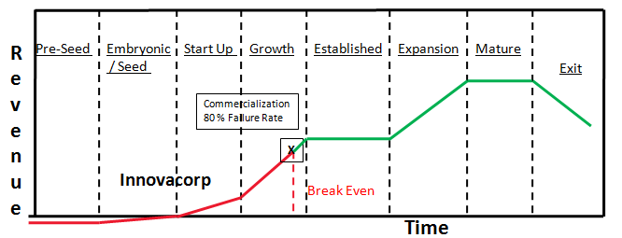
Stages of a Business Lifecycle
Universities
Road Shows
Incubators
Startup
Weekends
Accelerators
I-3
Sandboxes

Slide 28
Innovacorp’s I-3 Technology Startup Competition Growth
ICT Life Sciences Clean Technology Oceans Technology
228
25
5
1

Slide 29
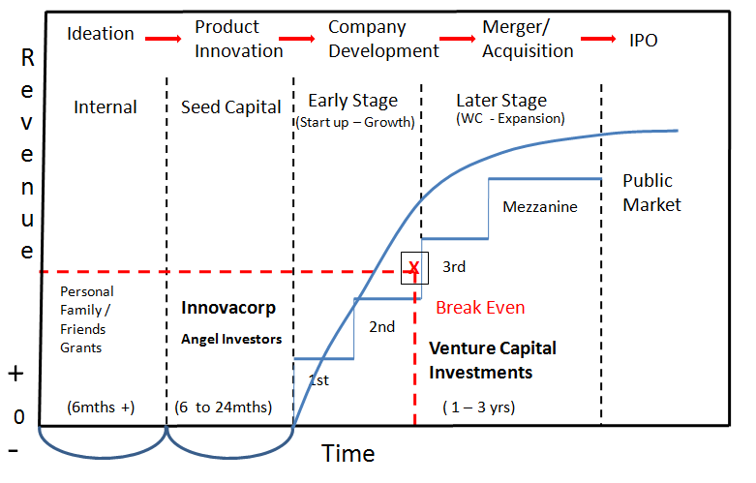
Traditional Product Investment Lifecycle
Technology
Companies
Build
Ventures
NSBI
NBIF
BDC, TVC, EVV
GW, Tech SE, AVCP
Entrevestor - Carol & Peter Moreira

Slide 30
Startup Failures

Slide 31
Startup – A Dual Challenge
How to search for a scalable & repeatable BM with a unique product or service and take it through a structured Innovation cycle and incubation process, to become a viable company
How to build the core competencies within the company, which will enable it to launch the product into the market place so the product and the company can be successful

Slide 32
Why Business Models Fail
Solving an Irrelevant Customer JOB
Flawed Business Model CAC > CLV
External Threats
Poor Execution

Slide 33
Transition
From Startup to Company
Product Market Fit
Scalable
Startup
Transition
Company
Business model found
Product /Market Fit
Repeatable Sales Model
Sales Managers Hired
Key Executives in place
Business Process Developed
Profitable – Cash flow
Rapid scale
Death Spiral
Transition Failure
Graveyard

Slide 34
Stages of a Lean Startup Life Cycle
Ideation
+
Founders
Embryonic Seed Stage
Search
Execution
BM Canvas
Cust - Dev
Pivot
VP Canvas
Key Partners | Key Activities | Value Propositions |  | Customer Relationships | Customer Segments
 | Key Resources |  |  | Channels
Cost Structure |  |  | Revenue Streams
Value Proposition
Customer Segment
Product / Market Fit
Pains
Gains
Early
Stage
Growth
Stage
Gain
Creators
Customer Job(s)
Pain
Relievers
Pains
Chasm
MVP
Innovators
Early Adopters
Early Majority
Agile Prod
Tech - Dev
Transition Failures
Startup Model Failures

Slide 35
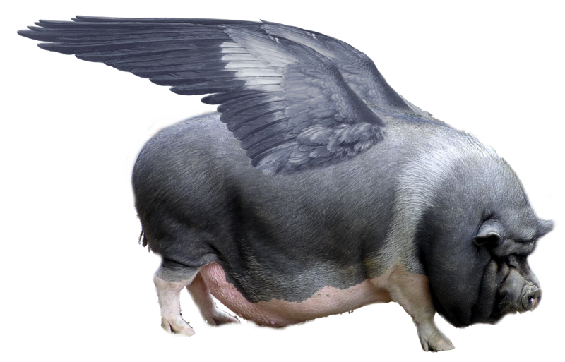
A Startup that has Crossed the Transition Chasm
Entrepreneur Startup Motto:-
“Pigs Can Fly!”

Slide 36
PD Summit Challenge
Create A Startup – “Best Business Model”

Slide 37
PD Summit Challenge* Create A Startup – “Best Business Model”
Select a small team with different skill sets:-
Business Systems Analysts- Customer Problem Definition - Need - Product / Market Fit
Infrastructure / Communication Analysts – Agile Dev
Application Development- Testing ( System / Mobile) – Agile Dev
Marketing Sales Analysts – Customer Development
Financial / Cost Accountant – Financial Assumptions & Cash Control
Project Manager – Activity scheduling – Business Model Canvas

Slide 38
PD Summit Challenge* Create A Startup - “Best Business Model”
Create a Founders Document to capture your ownership model
By May 30 / 14 e-mail 1 pg Summary to me - Confirmation
C-Level Execs will assign a mentor to support your initiative (20 hours of personal coaching for each team)
Teams research Lean Startup model concepts and Start building your Business Model Startup
C-Level Execs in Partnership with other participants in marketplace will organize a Startup Showcase to be held on Sat Sept 6, 2014 ( Location TBD)
20 Minute Presentation + Closed Door feedback will be provided by panel of judges to each team - Top 3 selected
This will be a feeder event to increase participation in the Innovacorp I-3 Startup Competition starting in Sept
*In order to create a critical mass, a minimum of 10 teams will be required to participate in the showcase

Slide 39
Startup Success Factors
Cluster of ICT Companies
Gov’t Seed Investors - $$
Venture Capital - $$
Educational Institutions - Educating + Partnering
Successful Entrepreneurs re-investing
Mentors / Coaches – C-LES
Business Leadership (JR- GP) 4Front
YOU !! The Entrepreneurs

Slide 40
We look forward to working with Innovacorp
Thank You
Questions ??
Daniel.Dolan@C-LevelExecs.com
CIO Practice Partner

Slide 41
Lean Startup - Prizes
Business Cards:- Names + e-Mail to get a copy of this Presentation
Business Model Generation :- By Alexander Osterwalder & Yves Pigneur
The Startup Owners Manual ;- By Steve Blank & Bob Dorf
The Lean Startup :- By Eric Reis

