Slide 1
Professional Development Summit 2014 D. Davis, CIO
Notes:
.

Slide 2
Advancing ICT
Opportunities & Challenges
ICT of the Past
The Imperative
Making the Change
Re-Positioning ICT
We’re Making a Difference

Slide 3
Opportunities & Challenges
Do more with less
Increasing citizen expectations
Transparent government
e-Services
Larger Projects
Demand for more efficient & effective
More performance-based
Being held accountable
Time to transform
Need to behave like a BILLION DOLLAR corporation

Slide 4
ICT of the Past
IT Frustration
Reduced IT Involvement
Budget & Staff Reduction
Reduced Business & IT Interaction
Increased Business Unit Frustration

Slide 5
The Imperative
What has changed?
Addressing the challenges & opportunities ahead
Challenges
-Credibility -Budget
Opportunities
-Meet Citizens Expectations
- Best Practices -Add Value
- Outsourcing - Alternative Service Delivery
-Transformation Services
Need to Transform
CIO

Slide 6
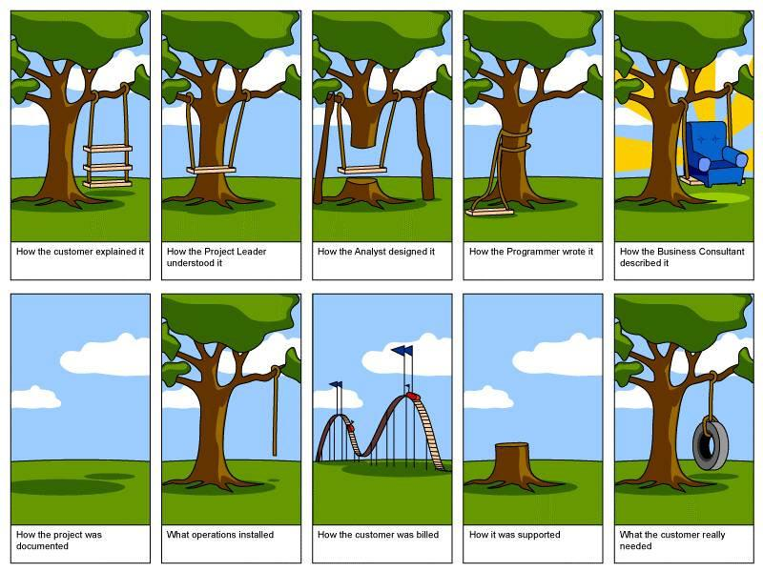
The Imperative
Opportunities to make a difference
Deliver the total package
ICT Must Add Value
Transform service provision

Slide 7
Making the Change
Slam in the system “Get it Done”
Implement quickly, but take the time to get it right
Implementation
Technical Approach
Business Approach
Define technical requirements
Define business process requirements
System Design
System Transaction Training
Process & Workflow Training, emphasize system as enabler of processes
Training & Organizational Change Management
Minimize Technical Bugs
Minimize Disruptions to Business & Maximize Business Results
Measures of Success

Slide 8
Making the Change
Skills
Relationship Managers
Business Analysts
Project Managers
Service Management Specialists
Planners-Strategists
Policy Writers
Change Management Experts
Progressive Leadership
Planning/ Best Practise
3 Year ICT Strategic Plan
Outsourcing
Portfolio Management
Service Management
Analytics Based Decisions
Operational Excellence

Slide 9
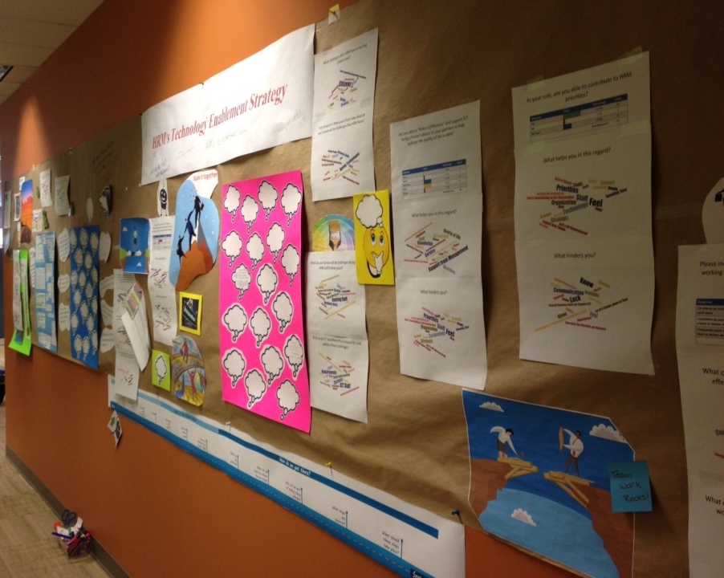
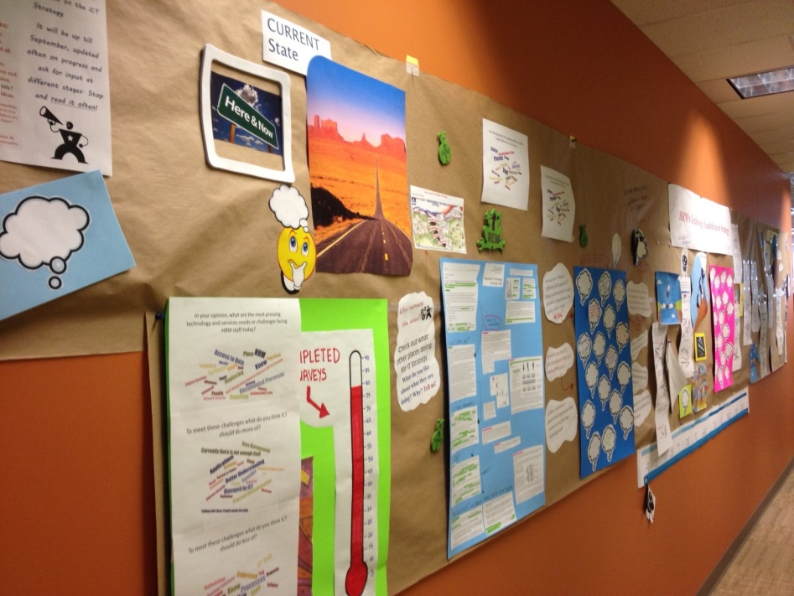
Making the Change
Embrace change – contribute to it
Develop new skills
Be part of the solution

Slide 10
Re-Positioning ICT
CITIZEN FACING
Transit AVL
Web Transformation
Corporate AVL
Online Permitting/Licensing
INTERNAL IMPROVEMENTS
Open Data
Online REC
TMR II
Digital Mugshots
Traffic Signals
Parking Strategy
Health & Safety Reporting
Fire e-Learning
Open Data
Unified Communications
Collaboration & Workflow
Document & Data Management
Business Intelligence
SAP
Print Managed Services
Mobile Workforce Strategy
REGIS II
LED Street Lights

Slide 11
Re-Positioning ICT
Project Capital Dollars
$16 Million
Transit Technology
$9 Million
3-5 years
$50 Million
This year alone!
What will the future bring?

Slide 12
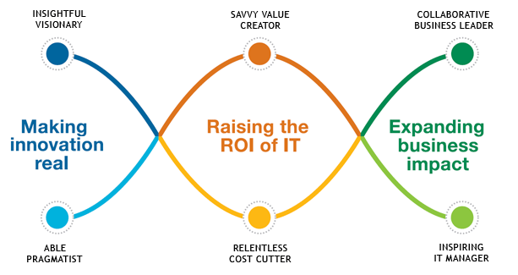
Re-Positioning ICT

Slide 13
Re-Positioning ICT
Be part of something big. Dare to make a difference.

Slide 14
We’re Making a Difference
Operate according to best practises
Embrace our influence and responsibility
Step up to support our City

Slide 15
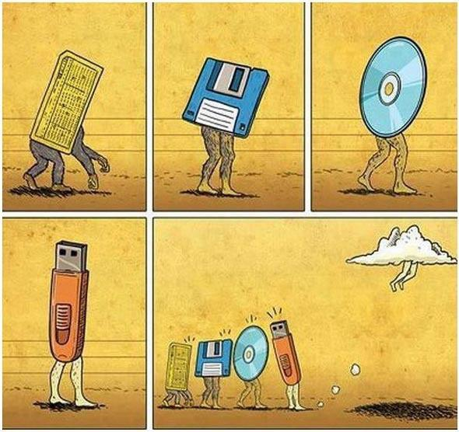
We’re Making a Difference
“We’ve come a long way, baby”
Stay Tuned!

Slide 16
We’re Making a Difference
Thank you!
Questions?
Donna Davis, CIO Information, Communications, & Technology Halifax Regional Municipality
davisd@halifax.ca

