Slide 1
Writing user-friendly requirements

Slide 2
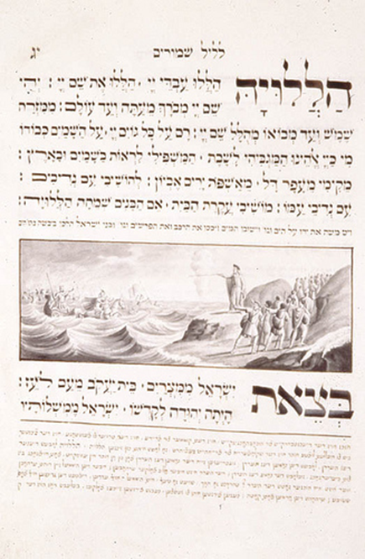
Notes:
I’d like to start by asking you to put yourself in the shoes of a non-expert reader.
Here is a page from a document written in Hebrew. Does anyone here read Hebrew? (If so, “Great, you can help us out in a minute.”)
For those of you who don’t read Hebrew, I want you to pretend that I’m giving you a Hebrew-English dictionary. How would you start working your way through the page?
Point out that Hebrew writing doesn’t work left to right—it works right to left. A convention…
Could you interpret the picture without the aid of the text?
Would just knowing the vocabulary enable you to make sense of the document?
Non-expert readers lack vocabulary and overall context, which means that they have trouble interpreting pictures (charts and diagrams), paragraphs, and even bulleted lists. In other words, they have trouble seeing a document the way an expert reader sees it.
So here’s the big question you have to be able to answer in order to write user-friendly requirements documents….

Slide 3
What do non-expert readers see in requirements documents?
Notes:
What you hope they see and what they actually see may be two different things.
Ask for show of hands:
How many people have created a detailed requirements doc but then have had to hold an extended Q&A session with the client, reviewing details clearly spelled out in the doc?
How many people have had to walk non-experts through a simple use case diagram step by step?
How many people have had a client sign off on a requirements doc without actually understanding the details?

Slide 4
Familiarity with conventions shapes understanding
Conventions: Agreed-upon practices that writers within a professional community follow when using language and document design.
Conventions may be formally or informally expressed by the community.
Notes:
An important aspect of “understanding” a technical document is actually knowing how to follow its conventions. (Note conventions on slide, such as boldface, ital, kicker, title in different font, watermark).
Conventions are essentially the customs of a professional community (community of practice). So, like the customs of an ethnic or regional culture, they may be formally expressed, or they may be informally understood.

Slide 5
Notes:
Some of the conventions you work with when you produce requirements documents could be captured in an organizational style guide. (Does anyone here work with one of those?) Other conventions might be unspoken “rules” or the habits that you and your colleagues have developed in response to personal quirks of your boss. (Example on slide could come from style guide or personal quirk.)
Wherever the conventions come from, it’s important to remember that non-expert readers are often totally unaware of how certain basic conventions of requirements documents work.

Slide 6
How many different conventions do you see in this diagram?
Image author: Kishorekumar 62
Notes:
Consider, for instance, use case diagrams. Even the simple diagram you see here relies on several different conventions that are well-known within the software development community of practice but largely unknown outside it.
How many different conventions do you see operating in this simple use case diagram showing how a restaurant works?

Slide 7
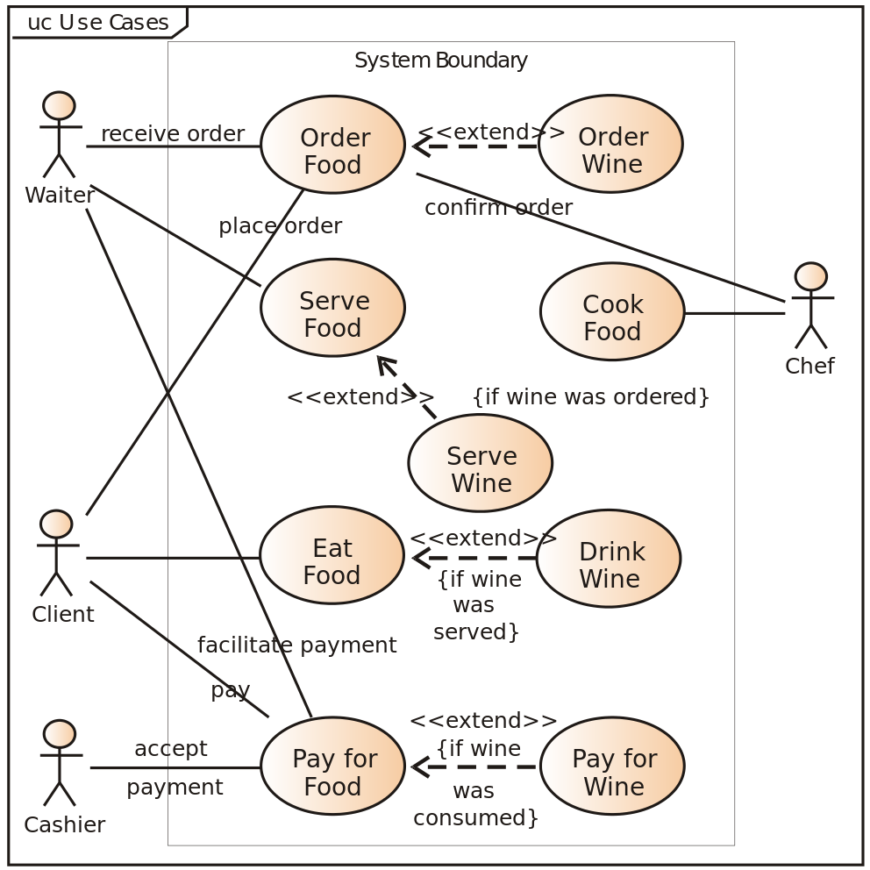
Successful requirements writing involves teaching non-experts about conventions
Notes:
To produce user-friendly requirements documents, then, you need to teach non-experts how to follow the conventions you’re using.

Slide 8
Four techniques for user-friendly requirements
Frame technical details by providing business goals and benefits
Use summary statements to introduce sections
Manage long bulleted lists by using parallelism and subdivision
Integrate use case diagrams and other visuals so they are easy to interpret
Notes:
We’re going to examine four practical techniques that you can use to help non-expert readers easily interpret the conventions of requirements documents and access the technical details you need them to understand.
As we explore each of the four techniques, we’ll be completing some exercises on your handout. Does everyone have a pen or pencil?

Slide 9
What are your priorities as a reader?
Clarity
Accuracy
Readability
Comprehensiveness
Notes:
To set the ground for the four techniques, let’s start by thinking about what non-expert readers are really looking for in requirements documents. Let’s imagine we’re circulating this brief questionnaire.
Left half of room = yourselves (experts)
Right half of room = non-experts
Ask participants to identify their number 1 priority. Then go through questionnaire and ask for show of hands for each item. How do two groups compare?

Slide 10
Experts tend to operate in zoom mode
Notes:
Most technical experts would choose clarity, comprehensiveness, and accuracy because they tend to operate in zoom mode—they zero in on the technical details of the technology they’re describing.

Slide 11
But non-experts function in panoramic mode
Notes:
But non-experts tend to have very different priorities. The number one concern for non-expert readers tends to be readability. That’s because non-experts tend to view technology in panoramic mode—that is, in high-level terms.

Slide 12
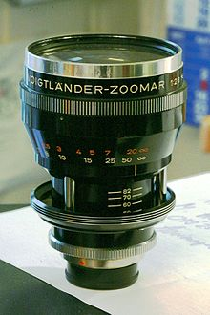
Requirements writers need to work in both modes
Notes:
The challenge, of course, is that effective requirements need to meet all four criteria, and they need to satisfy the needs of both experts and non-experts. As a requirements writer, you need to operate simultaneously in panoramic and zoom modes--and you need to make it clear when you’re shifting from one mode to another (because that’s part of helping your readers understand how the conventions of requirement writing work).
Each of the four techniques we’re going to examine will help you achieve this challenging feat of providing a dual perspective.

Slide 13
Technique #1: Frame technical details
Business context
Technical details
Notes:
Let’s start with the first technique which is to frame technical details by providing business goals and benefits, the practical context.
For non-experts, technical content makes sense only when it’s framed in the context they understand. Most people recognize this when it comes to proposal writing; they realize how essential it is to articulate a clear business case aligned with an organization’s goals—and the language it uses to express those goals.
Even though requirements documents play a different role from proposals, their success with the reader also depends on the clarity of the business case. Though we may think of requirements as informative documents, they must also be persuasive, on at least two levels. First, you need to engage readers and persuade them to give your document their attention. Second, you want to convince your readers to sign off on the technical vision you’re presenting.
Exercise 1: Compare purpose statements.
Exercise 2: Making context statements precise and jargon-free

Slide 14
Non-expert readers need help navigating
Notes:
It’s not enough just to provide the business context at the beginning of your document. Doing that will help your non-expert readers focus—once they understand the frame, they can zoom in on the details you need them to examine. However, readers who lack technical knowledge can easily lose their way when trying to navigate dense technical information. To keep them on track, it’s important to give them some reading aids, some supports or signposts to help them stay on the path.
So let’s turn to our second technique…

Slide 15
Technique #2: Use summary statements
Introduction
Overview of document (roadmap)
Section title
Overview of section
Section subtitle
Technical details
Notes:
Headings alone may not provide a clear enough path for your non-expert readers, who often need help connecting the dots—seeing the relevance of various bits of technical information to the application or system as a whole and to their big-picture preoccupations (their business concerns).
For those readers, summary statements play a key role. Here’s an example….

Slide 16
Example of progressive summary statements
Purpose
This document describes the requirements for building a secure online application for tracking mileage and repairs for company vehicles. Stakeholders of the application include managers, sales representatives, and accounting personnel.
Access requirements
To accommodate the needs of the various stakeholders, there will be three kinds of accounts: Administrator, User, and Auditor.
Administrator accounts
[bulleted items]
Notes:
To use summary statements effectively, try thinking about how you might present the information to a live audience. When we deliver oral presentations, we tend to be aware that we need to build in extra supports for our listeners to help them stay on track. For most of us, for instance, it’s second nature to provide an agenda at the beginning of a presentation.
Just as listeners are disadvantaged by not having the text of your presentation in front of them, non-expert readers are disadvantaged by lacking familiarity not just with the technology you’re describing but also with your descriptive methods, with the way you package your requirements into document form. So they appreciate these very basic helps, these simple reminders that don’t add a lot of text to your document but go a long ways toward making them user-friendly.

Slide 17
Be consistent with structure and key terms
System use case list
The system will be organized into three functional business packages: user registration, mileage tracking, and repair tracking.
User registration
[use case in table]
Repair history
[use case in table]
Mileage tracking
[use case in table]
Notes:
Point out issues with “repair history”—item is out of order, and language changes. Seems a very basic error here, but it’s one that crops up all the time in technical documents. What’s easy to see in a single screen of text is not so easy to see when you’re dealing with a 50-page document.
Consistency is important not just for reader comprehension but also for building credibility. Each time you provide an overview statement (as under “System use case list”), you create an expectation as to what will follow. You’re making a kind of promise to the reader, in other words. So the more consistent you are in your organization, the more trustworthy you appear to the reader—and trust, we know, is a key element in persuading someone to approve your document.
Exercise 3: Aligning summary statements

Slide 18
Technique #3: Manage bulleted lists
Use parallel structure
Subdivide long lists when you can
Respect the limitations of lists
Notes:
Consistency is also key when you’re presenting information in bulleted or numbered lists.

Slide 19
A lack of parallelism creates a jarring effect
Functional areas will be assigned to groups.
Groups can contain up to three subgroups.
Group name restrictions
A name can be no more than 30 characters.
A name must begin with a letter.
Notes:
First point: use parallelism.
Parallel structure is a grammatical requirement of clear writing. When writing displays parallelism, each item in a list follows the same grammatical structure. When there is a lack of parallelism, one or more of the items in the list appears “out of sync,” or out of step, with the others. What is the issue with this list?

Slide 20
Which of the following items is out of sync?
Users will be able to access the system through
the Web portal
logging on to their desktop machines
personal smartphones

Slide 21
Which of the items is out of sync?
4.2 Pre-conditions
ANT is properly installed.
Wi-Fi is enabled.
The user has run the Tablet Cleanup utility.
Auto-save has been disabled.

Slide 22
Which of these items is out of sync?
Path #1
The user starts ANT.
The system connects to the default database.
Next, the ANT login screen is displayed.
The user enters a user ID and password.

Slide 23
When possible, follow the “5 to 7” rule
5 to 7, +/- 2
Notes:
Second point: subdivide long lists
Exercise 4: Grocery list

Slide 24
Ways to subdivide content in a list
Create sub-bullets
Add headings
Insert horizontal rules
Use color coding (with caution).
Create running heads (put the first word of a bulleted paragraph in bold).
Notes:
How many ways can you think of to subdivide a list?
Which of these methods do you use now?

Slide 25
Tips for creating long lists that can’t be divided
Keep each list item short (to one or two lines).
Allow ample white space before and after the list.
Consider using bold type to emphasize key words.
Be vigilant about following parallel structure.

Slide 26
Respect the limitations of bulleted lists
Bullets do not necessarily suit all material.
They are meant to present lists of examples or benefits, rather than ideas that need to be logically linked.
They lack the unifying devices of a traditional paragraph (such as transition words).
They should not be used to group together ideas that are complex or are not already clearly interconnected.
Notes:
Third point: Respect the limitations of bulleted lists.
Point out issue with the way bullets are used on this slide; a paragraph would be more appropriate to develop the idea.

Slide 27
Use bulleted lists strategically
Bullets do not necessarily suit all material because they lack the unifying devices of a traditional paragraph, such as transition words. Use bullets in these situations:
You need to present an itemized list of examples or benefits
Your ideas are straightforward and already clearly interconnected
Notes:
Use bullets for examples, lists of features. Bullets provide visual emphasis.

Slide 28
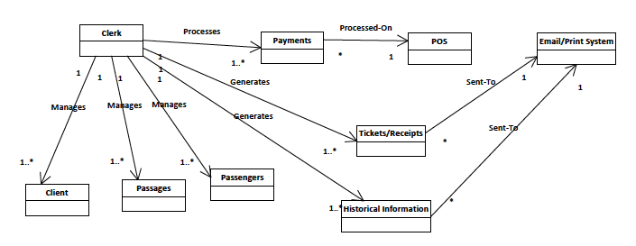
Technique #4: Integrate diagrams and visuals
T
The following diagram shows the activities a clerk performs and the system outputs that result.

Slide 29
Introductory phrases to keep in mind
The following table shows…
The use case diagram below illustrates…
As the following table demonstrates…
These four steps are outlined in the following diagram.
The following workflow diagram presents…
Notes:
For novice readers, a “how to use this document” section at the beginning might be helpful if there are a lot of diagrams.
Exercise 5: Integrating diagram

Slide 30
Work with your readers’ assumptions about design
Readers will assume that
text that appears in bold is more important than normal text.
numbered list items indicate chronology, priority, or point of reference.
colour is meant to emphasize content.
a change in font has significance.
items positioned close to each other are closely related in meaning.
tables and diagrams will follow the same, predictable formats
Notes:
Non-expert readers need training to interpret a diagram-rich document. The training will work best if you work with their native assumptions.

Slide 31
How to put yourself in a non-expert’s shoes
Have I stated how the application or system will fit into the reader’s world and promote business objectives?
Have I used summary statements to make my document easy to navigate?
Have I used parallel structure in my bulleted lists?
Have I considered ways to organize bulleted lists for easy reading?
Have I provided proper introductions to my tables and diagrams and clearly labeled them?

Slide 32
The four techniques create self-guiding documents
Notes:
You can’t stand beside non-expert readers and guide them as they work their way through your detailed requirements documents. But by using the four techniques we’ve touched upon today, you’ll create self-guiding documents that teach non-experts the conventions of requirements documents and thus make your documents user-friendly. That means fewer headaches for them and a quicker, smoother sign-off process for you. When you take the time to put yourself in your readers’ shoes, adapt to their priorities, and ad, everybody wins.

Slide 33
Dawn Henwood
VP, Instructional Design
Smartfirm Inc.
902-817-0127
dawn@smartfirm.com
Follow Dawn on Medium

